Slide 1
WHY DOES RACIAL STRIFE EXISTS BETWEEN WHITES AND BLACKS IN AMERICA?
Carbon neutral since 2007
All of the photos and images were taken from Google images copyrighted material contact information Micheal J Darby jonah68@gmail.com phone number 910 352 8943

Slide 2
Table of contents click on desired section
Ignorance, Indifference, And Prejudicial Attitudes
B. Superior Attitudes: Feelings of racial superiority can hinder sound race relations
C. Communication and Media Systems: The media has the power to initiate positive
changes in race
D. Competition: Play by the same rules regardless of race
E. Social, Economic Differences: Bridging the economic gap can lead to better race
relations
F. Educational, Governmental, Parental, and Religious Institutions
G. Stereotypes: Stereotypes have caused a lot of pain in the human family
H. Bad Experience: Persons of all races, colors, and creeds initiate bad experiences.
I. Inferiority: No Race is Superior or Inferior
J. Sexual Myths: Sexual Stereotypes Dehumanize
K. Skin Color and Physical Characteristics
Table of contents continued

Slide 3
Table of contents click on desired section
L. The Fear of Assimilation:
M. Mixed Marriages:
N. The Lack of Association and Exposure: A Failure to associate with others
O. Intolerance of the Customs and Habits: Learn about others before passing judgment.
P. Language and Dialect: Language and Dialect should not initiate feelings of
discrimination and prejudice.
Q. Scapegoats: Blaming others for one's shortcomings
R. The Myth of Africa: Africa has a rich history of Mathematics and Medicine.
S. Physical and Intellectual Inferiority:
T. Race Hating Groups: Hate Destroys Innocent People
U. The Criminal Justice System:
V. The Lack of Adequate Minority Representation:
W. The Lack of Conviction: Stand Against Racism
Y. The Lack of Involvement of Religious Institutions:
Z. The Lack of Respect and Brotherhood:

Slide 4
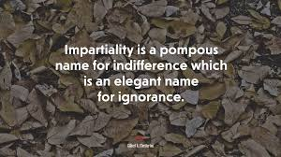
A. Ignorance, Indifference, And Prejudicial Attitudes: (Get the facts before judging other races and cultures)
Religious, Political, Educational, Parental, and Media Institutions all share the burden of being fair and impartial regarding racial concerns. These institutions can improve human relationships through honest, unbiased reporting and teaching. All of the mentioned institutions have the power to bring about positive change in race relations.
When these institutions realize the importance of improving race relationships, they will draft a roadmap for change and work vigorously to address racial concerns severely and uncompromisingly.

Slide 5
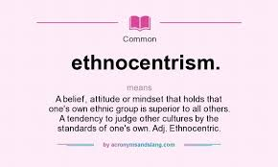
B. Superior Attitudes: Feelings of racial superiority can hinder sound race relations
Open feelings of racial superiority have been a significant source of pain and frustration through the ages. Ethnic cleansing in Rwanda, Bosnia, and Yugoslavia were classic examples of the devastating effects of ultra feelings of racial or religious superiority.
Bosnians, Rwandans, and Yugoslavians battled extensively in the name of ethnic cleansing. As a result, people lost their homes and lives trying to escape ethnic hatred for hundreds of years.
One of the real tragedies of ethnic cleansing is that it has left thousands of innocent children without mothers and fathers, leaving them to die of disease and starvation. The physical devastation has been horrific, but the long-term psychological effects will remain for a lifetime for the innocent children caught up in a senseless war of ethnic hatred.
Continue to the next section.

Slide 6
C. Communication and Media Systems: The media has the power to initiate positive changes in race
The Mass Communication system has grown in power and influence. Media commentary has formed or shaped our views on race and culture. The way the media have portrayed persons of different races has influenced how others perceive those who do not share their heritage.
Responsible, caring, objective media have the potential to be a massive plus in the fostering of sound race relations. The media can make a difference in race relations, for good or bad. Therefore, we call on the media to make positive changes in race relations.

Slide 7
D. Competition: Play by the same rules regardless of race
America is a competitive country. Some form of competition exists in most areas of life. There is competition in sports, employment, politics, and education.
People of all races compete for the same jobs, educational opportunities, etc. A person’s race was a significant factor in who received prime employment and educational opportunities in the past.
In contemporary life, a person’s race determines who works in certain positions. For example, the National Football League and the Major Leagues hire very few Black Coaches and Managers, although many players are Black. Playing on a level field is needed to ensure fairness in the workplace and other areas of life. Suggested strategies:

Slide 8
E. Social, Economic Differences: Bridging the economic gap can lead to better race relations
The average white household income is $21,000s more than the black household income. Many low-income blacks and whites are unemployed and malnourished. There is a misunderstanding by many hardworking Americans as to why low-income blacks and whites would allow themselves to get into such a predicament.
The perception that poor blacks and whites are shiftless, lazy people has hurt race relations. We live in an era that criticizes low-income people. However, it is essential to be aware that a devastating accident or illness leaves many affluent people one step away from poverty.
Unemployment and income References: (Economic Policy Institute www.epi.org/content.cfm/webfeatures July 5, 2006) (Black Newsamericaweb.com Monday, December 05, 2005, Michael H. Cottman ) (United States Department of Labor Website)
Suggested solutions:

Slide 9
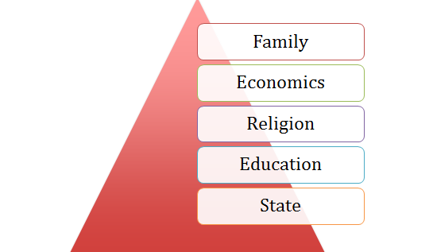
F. Educational, Governmental, Parental, and Religious Institutions: All major institutions should promote good race relations.
The major institutions of Education, Government, Parenthood, and Religion have more influence than any other institutions in American life. When these great institutions decide that solid race relations are essential for this nation's intellectual, spiritual, social, and mental well-being, race relations will improve in all areas.
A person’s race has impacted all of the listed institutions throughout history. How each Institution has responded to race has had significant ramifications in all facets of life. Furthermore, each Institution’s position on race during specific historical periods shaped the views of the general populace. Contemporary men and women still tend to follow the lead of the above institutions; therefore, if there is an improvement in race relations, it will come through the mentioned institutions.
Suggested solutions

Slide 10
G. Stereotypes have caused a lot of pain in the human family.
Some old racial clichés remain firmly embedded in the American Psyche. For instance, many feel that black worship services are more emotionally charged than their white counterparts. Likewise, poverty and illegitimacy are viewed as black or brown problem, although whites are affected in high numbers.
Negative Stereotypes are probably the most threatening obstacles to forming good race relations. More damage has resulted from negative stereotypes than all other barriers combined. Placing an entire Race in one giant category does not help build personal communication bridges.

Slide 11
H. Bad Experience: Persons of all races, colors, and creeds initiate bad experiences
An old expression is, "In everyone's life, some rain must fall." Life is a mixture of the good and the bad. The challenge is how one responds to positive and negative experiences. Some persons have had one bad experience with an individual of a different race, and they allow that one experience to color all future relations they have with other persons of that race.
Reflecting on the negative rather than the positive tends to lead to division and chaos. Good race relations are too precious to allow a single negative experience with an individual of a specific race to denigrate all future dealings with those of that race.
Suggested solutions:

Slide 12
I. Inferiority: No Race is Superior or Inferior
The expression "What a man thinks, so is he" is a prevalent saying. Suppose a person thinks or feels that they are inferior. It impacts how they relate to other people, especially in race relations. No sound race relations will develop if feelings of inadequacy and inferiority flourish.
Possessing a positive self-image is crucial to building positive relationships with others. An old proverb says, "if you do not love yourself, you cannot love anyone else."
Parents need to be aware that Jean Piaget, a famous Swiss psychologist, believed that most of a child's personality develops in the first six years of a child's life. During this time, a child forms a positive or negative self-image. Therefore, parents who possess this knowledge can influence their children positively.
Suggested solutions:

Slide 13
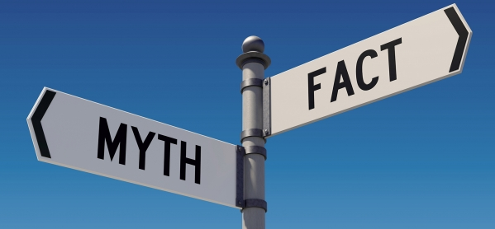
J. Sexual Myths: Sexual Stereotypes Dehumanize
Sexual Stereotypes have played a significant role in dehumanizing individuals to animalistic levels. It is easy to reduce people to an animalistic level when reduced to sexual objects or things. Likewise, the cycle of abuse is more leisurely when sexual stereotypes dehumanize men and women.
Suggested solutions:

Slide 14
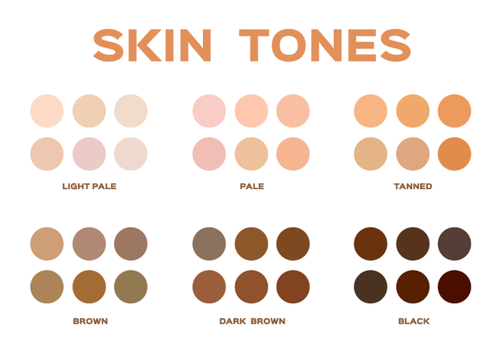
K. Skin Color and Physical Characteristics: Skin Color and Physical Characteristics should not be factors in judging character or morality
Sometimes people are judged by their skin color rather than by their character's content. When a person allows their preconceived notions about skin color and physical differences to interfere with meaningful association with persons of different races, it hinders relationships, which in some cases have the potential of being joyous and prosperous.
Persons of different skin colors and physical characteristics exist in the world. Viewing these as distinguishing physical attributes rather than character and morality markings becomes an ally to race relations rather than enemies.
Suggested solutions:

Slide 15
L. The Fear of Assimilation: The fear of assimilation should not initiate discrimination toward others.
There is a fear of assimilation because many want to maintain their racial heritage and identity. Feelings of racial pride are normal and healthy, but they can become very harmful when one allows these feelings to deny the rights and privileges of other racial groups. In reality, there should be a celebration of people's differences and their heritage's uniqueness. Cultural and Racial differences are the primary reason why diversity exists in the fields of Art, Literature, Sports, culinary, etc.
Avoid promoting racial malice and hatred out of the fear of racial assimilation.
The fear of assimilation should never cause one to act negatively toward those of other races. Total assimilation of Blacks and Whites in America is unlikely because of an increasing interest in identifying with one's heritage and background.
. Suggested solutions:

Slide 16
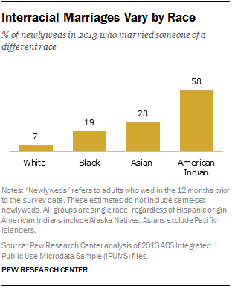
M. Mixed Marriages: Disdain of Mixed Marriages should not be a Lightning Rod for the promotion of racism.
Mixed Marriages have been a source of frustration for law-abiding citizens. Many people on both sides of the color line feel that mixed marriages are morally and socially wrong. Some couples involved in diverse marriages have been abused physically and emotionally by their families and the society in which they live.
There have been times when the hatred of mixed marriages has catalyzed the mistreatment of an entire race of innocent people. The blind rage of racism usually strikes without weighing the consequences or the cost of racial division. The tragedy of allowing negative feelings of racial anger to influence our daily dealings with persons of different races is that it has the potential to destroy many bridges that could lead to sound race relations.
Suggested solutions:

Slide 17
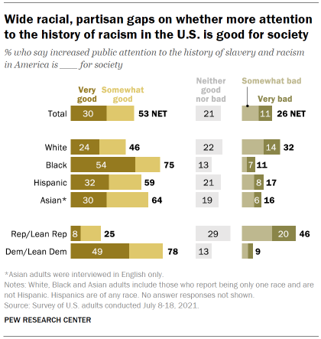
N. The Lack of Association and Exposure: A Failure to associate with others
People tend to fear the unknown. Unfortunately, in race relations, many honest, hardworking people on both sides of the color line have allowed negative rumors and gossip to color their views of persons of other racial backgrounds. A proverb says, "a man or woman must experience life for themselves." The person who associates and fellowships with persons of different races tends to be more tolerant of racial differences and has more realistic views of the customs and habits of persons of different racial backgrounds.
Suggested solutions:

Slide 18
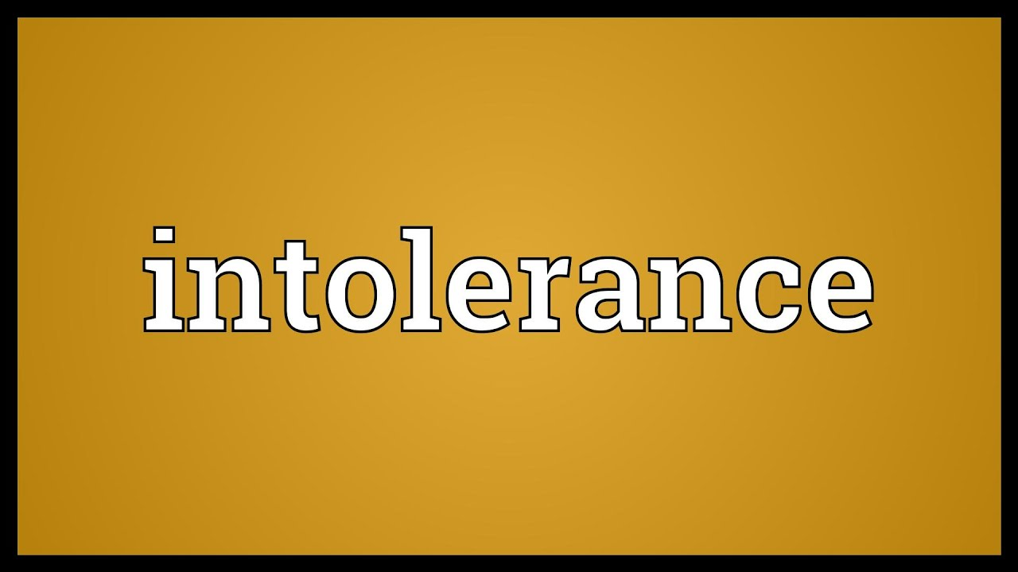
O. Intolerance of the Customs and Habits: Learn about others . before passing judgment.
Intolerance of the customs and habits peculiar to a specific race of people can cause severe problems among persons of different racial backgrounds—people of all racial groups desire that others respect their heritage and customs. Ethnic pride runs very deep in the lives of most people. Some persons have chosen death rather than surrender their heritage and background. Persons interested in improving race relations tend to increase the odds of bridging the gap among the races when respecting cultural differences.
Suggested solutions:

Slide 19
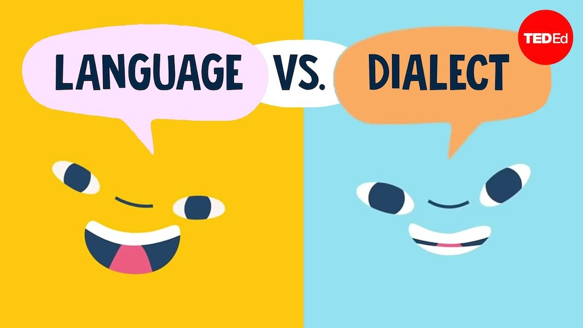
P. Language and Dialect: Language and Dialect should not initiate feelings of discrimination and prejudice.
In many instances, how one reacts to the language or dialect of other people will determine the relationships or associations that arise from being around people of different racial or cultural backgrounds. The person offended by the language or dialect of others tends to feel somewhat uncomfortable in being in the presence of persons who speak a language or dialect they deem inferior. Very few positive human relationships will occur when there is no tolerance for being in the presence of those who may speak a different language or dialect.
There is little chance of any meaningful exchange of cultural interests and ideas. The real danger of judging others merely by their language or dialect is that it may cause a person to overlook some of the positive and exciting characteristics of the person in question.
Additional solutions:

Slide 20
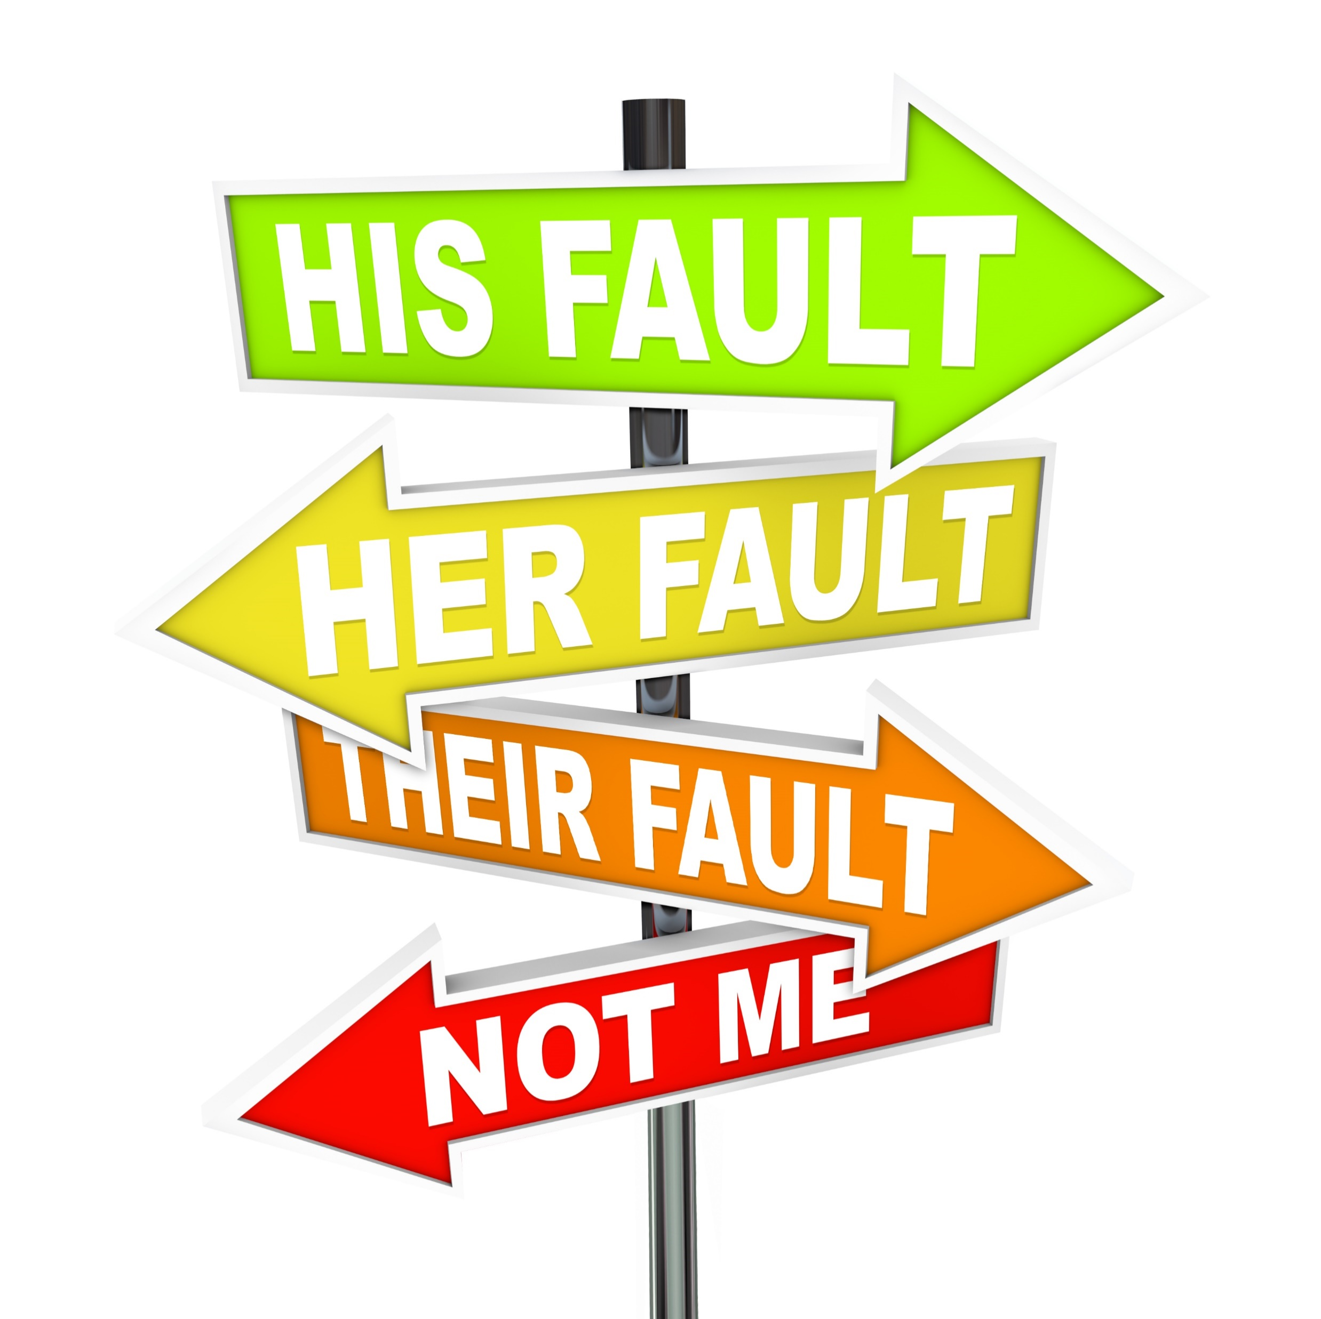
Q. Scapegoats: Blaming others for one's shortcomings
In history and literature, blaming others for personal failures has been an issue. It is harmful when one individual blames others for their losses and weaknesses, but it is devastating when blaming an entire race for most of the problems of a nation.
Some of the most horrific crimes in history have occurred when blaming a whole race for the region's problems. The destruction of Jews in Germany and the ethnic conflicts in Bosnia, Rwanda, and Yugoslavia are examples of when a select group of people is used as scapegoats to solve a nation's problems. Suggested solutions:

Slide 21
R. The Myth of Africa: Africa has a rich history of Mathematics and Medicine.
Some view Africa as a vast, uncivilized country with no significant artistic or scientific contributions. They overlook Africa's rich dance and artistic history, disregard the vast herb resources used to fight various diseases, and discredit oral and written proverbs and other forms of literature.
Many people in the Baby Boom generation grew up in an era when Hollywood portrayed Africa as a vast, remote country. A fictional character called Tarzan was a master of Africa. He was a mighty man blessed with wisdom living among various barbarian African tribes that placed him in danger and harm. Unfortunately, remarkably few positive images portrayed Africa in a civilized vain.
Suggested solutions:

Slide 22
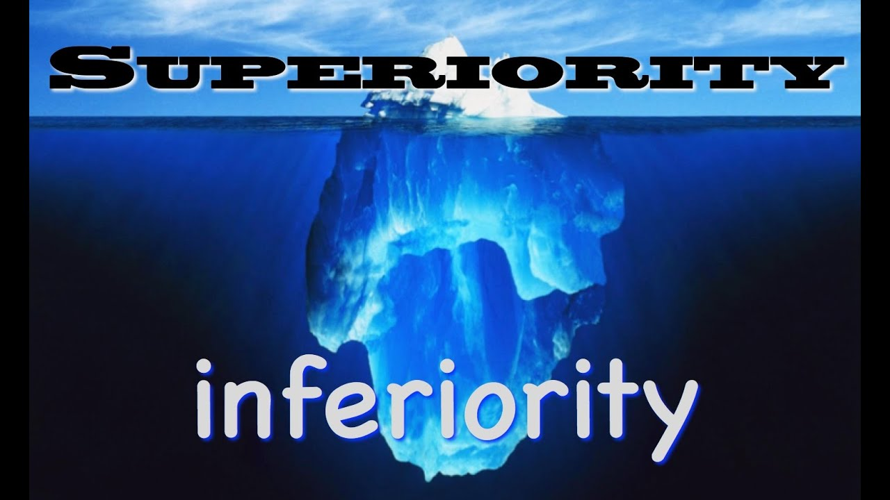
S. Physical and Intellectual Inferiority: Different levels of Physical Abilities And Intellectual Skills exist in all races.
The belief that one's specific race is physically or intellectually superior to another race promotes extreme racial pride, which sometimes catalyzes trivializing or belittling other races' contributions. It is essential to know that every race has gifted and talented individuals and persons of average or below-average intelligence.
Suggested solutions:

Slide 23
T. Race Hating Groups: Hate Destroys Innocent People
Those who promote racial hatred pose a significant threat to positive race relations. They intimidate and harass specific racial groups for no reason other than simply being members of a race they consider inferior. The trend of many contemporary race-hating groups is recruiting youth to carry out the harassment of targeted racial groups.
Many young people who join these groups maintain the scars of racism throughout their lives. They hate without knowing why they hate and hurt others without knowing why they hurt others. The tragedy of racial hatred leaves a legacy of senseless, irrational pain and suffering.
. Suggested solutions:

Slide 24
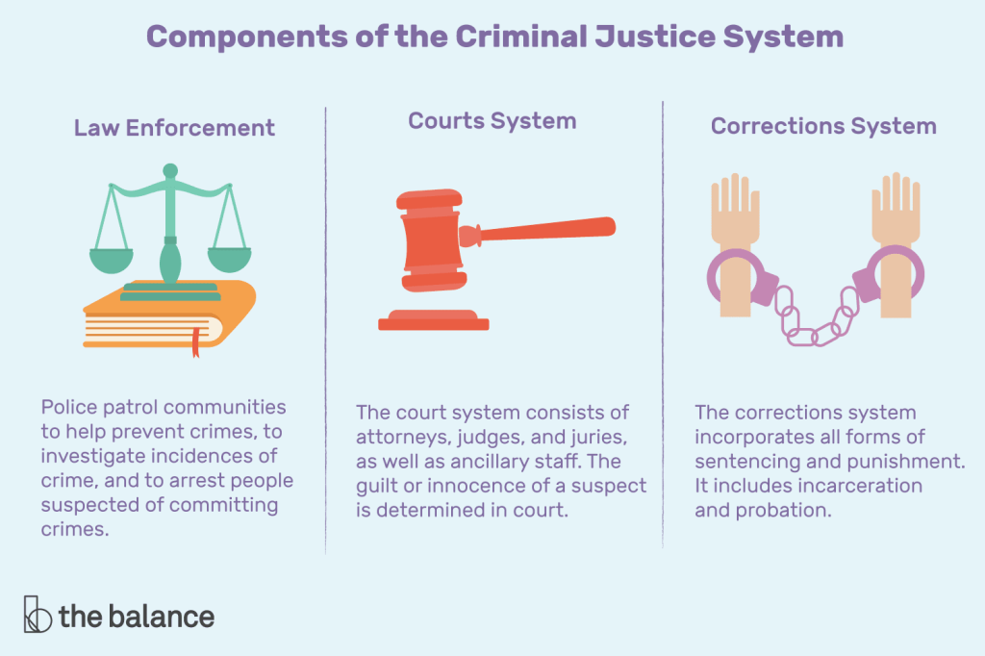
U. The Criminal Justice System:
The Criminal Justice System should always be fair and impartial regardless of Race, Color, or Creed. The Judicial System is responsible for administering justice based on legislated laws rather than personal subjective feelings and emotions. Persons of all races and creeds are entitled to fair colorblind justice. In an ideal legal system, money, race, and prestige would not factor in determining guilt, innocence, or length of punishment.
The legal system becomes a mockery when persons of privileged social-economic backgrounds are allowed to buy justice out of the abundance of their wealth and prestige. When people feel they are being treated fairly within the legal system, it promotes well-being and harmony among persons of different social, economic, and racial backgrounds.
Suggested solutions:

Slide 25
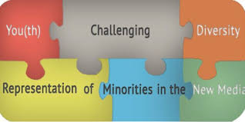
V. The Lack of Adequate Minority Representation: All races should be a part of the decision-making process.
The lack of adequate minority representation in business, medical and legislative positions has plagued race relations in America for years. The statistics are plain to see. Less than six percent of the nation's businesses and corporations are Black-owned and operated. Blacks comprise less than six percent of the nation's medical doctors and lawyers. During the publication of this article, there was one Black Senator, and less than nine percent of Congress is Black; this is under-representation in any language when statistics indicate that fourteen percent of the population of America is Black.
Moreover, under-representation in responsible positions usually leads to under-representation in undesirable places. For example, black Americans make up 40% of the prison system. In addition, unemployment is more than twice that of Whites.
Under-representation has caused only some of the mentioned problems. No single factor is entirely the blame. Still, it is a safe assumption that under-representation has played a significant role in most of the mentioned problems.
Black-Owned Firms (source of information http://www.census.gov/prod/ec02/sb0200csblk.pdf Black
Physicians, Surgeons, and Lawyers (source of information)
http://www.census.gov/PressRelease/www/releases/archives/facts_for_features_special_editions/003721.l
Black congressman (source of information) http://www.house.gov/fattah/features/faq.htm
Black Incarceration Punishment and Prejudice (source of information) http://www.hrw.org/reports/2000/usa/Rcedrg00-01.htm#P149_24292
Unemployment information http://www.bls.gov/news.release/empsit.nr0.htm
Suggested solutions:

Slide 26
W. The Lack of Conviction: Stand Against Racism
Many persons who abhor racial prejudice will not support a cause, give money or speak against racial bigotry. They are too afraid to get involved in racial issues, which has hampered racial relations. Yet, taking a stand is essential in the fight for racial equality.
The lack of a solid personal identity plagues many Americans. They simply
do not know enough about themselves to be in touch with their own personal
emotions and convictions. They, in turn, are not able to build bridges of
genuine communication with other races because they are not firmly
anchored in responsible thinking patterns that would inspire them to have
a devout interest in race relations.
Suggested solutions:

Slide 27
X. Make Your Convictions Known
Spread Words of Racial Harmony Among your friends. Persons who hate racial prejudice must make their convictions known if there's lasting progress in race relationships. Positive Racial beliefs are like moral and religious convictions. Those who desire good race relations should make their views known compassionately with an educational objective. Fighting fire with fire is not the answer because it would lead to chaos and further racial strife.
One man’s or woman’s courage can make all the difference in race relationships. Reprimanding friends or relatives who hold negative racial views is not an easy task, but there are times when friends should be made aware of their opposing views.
Suggested solutions

Slide 28
Y. The Lack of Involvement of Religious Institutions
Meet the challenge and get involved. America has a mono-racial church system, divided along racial lines. As a result, religious Institutions have minimal impact on promoting good race relations.
Time for Religious Institutions to take a Stand on Race
Religious Institutions have lagged far behind secular organizations in race relations. The NAACP and other secular organizations have made much progress in fostering sound race relationships.
Suggested solutions:

Slide 29
Z. The Lack of Respect and Brotherhood: Respect for the rights of others are essential in a Multicultural Society
Unprovoked racial hatred is a problem that has plagued sound racial relations in America for years. History bears the blood of men, women, boys, and girls who were dismembered, disfigured, and murdered simply because of their racial or ethnic background. A lack of respect for human life and brotherly love is the root cause of much of the blatant racial hatred.
Lynching in the United States (a comprehensive overview of lynching is found on the following website: http://en.wikipedia.org/wiki/Lynching_in_the_United_States
Suggested solutions:

Slide 30
A. Ignorance, Indifference, And Prejudicial Attitudes:(Get the facts before judging other races and cultures)
When these institutions realize the Importance of improving race relationships, they will draft a roadmap for change and work vigorously to address racial concerns severely and uncompromisingly.
Suggested Strategies to overcome
sponsor human relations programs
encourage others to respect racial differences
write literature on positive human relations
show films on cultural contributions
sponsor racial sensitivity training
promote books written by people of different cultures and races
air television programs on working together
continue to pass laws that are fair to people of all races and cultures
make an effort to write fair and objective history books
Return to the table of contents. Continue to the next section

Slide 31
B. Superior Attitudes: Feelings of racial superiority can hinder sound race relations
Solution Response:
There is a difference between taking pride in one's cultural or racial heritage and feeling superior to those of other races. Most people show very little respect for those to whom they feel fine. It is impossible to achieve sound race relations when one race has ultra feelings of superiority over another. History teaches many lessons. The lessons on excessive feelings of racial superiority are that they tend to lead to abuse and oppression. It is human nature to exploit those or that viewed as inferior. It is important to remember that it is possible to possess a deep sense of cultural and racial pride and, at the same time, view persons of other races and cultures as equals.
Strategies to Overcome Feelings of Racial Superiority
focus on the positives of other racial groups
respect the rights of different cultures and races
focus on the humanity of all races
fellowship and association with other races
read about the achievements of all
Return to the table of contents. Continue to the next section.

Slide 32
C. Communication and Media Systems: The media has the power to initiate positive changes in race
The Media has emerged as one of the most influential institutions in American life. Television, Computers, Radios, and Print Media have maximized their influence in recent years. Talk Programs and News Commentaries dominate the airways. They discuss various subjects such as food, health, education, crime, sports, religion, and parental responsibilities. In addition, they have expert journalists who comment on morality and the values we should embrace as citizens of the world.
Many television personalities work for the Psychic Network to entice the public to call in for a reading. Pornographers air pictures on the Internet, influencing young minds to explore the world of sexual exploitation. Radio and Television Talk Shows, print media, and certain newspapers espouse their personal political views.

Slide 33
Media solutions
The challenge, which confronts the media, is that America is a multicultural and multi-racial society. One set of views does not fit all; therefore, it is essential to be objective and fair in reporting news and commentaries.
The Media can influence the masses in any way it chooses. A positive spin on race relations would be a massive step toward making America a more peace-loving, pleasant place.
Suggested Media Strategies to Improve Race Relations
air programs, which encourage racial harmony
print commentaries on what different communities are doing to improve relations
publish personal profiles of leaders who have made
contributions in the area of racial relations
have a regular commentary on improving race relations
promote books on improving race relations
do documentaries on solid race relations
Return to the table contents. Continue to the next section

Slide 34
D. Competition: Play by the same rules regardless of race
Solution Response:
Competition impacts the American lifestyle. Parents encourage their children to do their best when competing with others. For example, some families compete with other families to see who builds the most prominent house or drives the most expensive car. As a result, material wealth determines success rather than moral values.
A win-at-all-costs attitude has gripped many segments of American life. Little League fathers fight over disputed games. Coaches who do not produce an instant winner tend to lose their jobs at all levels before their contracts are up.
Many professional athletes have very little loyalty to their teams. As a result, sporting Franchises move from city to city in search of more financial resources, leaving thousands of loyal fans behind.
Suggested strategies continued

Slide 35
D. Competition: Play by the same rules regardless of race continued
Competition is healthy when there is a sense of fairness and sportsmanship, but it becomes detrimental when it becomes the primary goal; this is especially true when people of different races and cultural backgrounds compete against each other.
Adding a racial component to competition can have devastating effects; therefore, it is essential to play by the rules regardless of whom you are playing against.
Fair Competition Strategies:
always compete with a sense of fairness
respect the humanity of the other person
be a good sport, win or lose
appreciate the talents and skills of those of different races
Return to the table of contents. Continue to the next section.

Slide 36
E. Social, Economic Differences: Bridging the economic gap can lead to better race relations
E. Social, Economic Differences: Bridging the economic gap can lead to better race relations
The average white household income is $21,000s more than the black household income. Many low-income blacks and whites are unemployed and malnourished. There is a misunderstanding by many hardworking Americans as to why low-income blacks and whites would allow themselves to get into such a predicament.
The perception that poor blacks and whites are shiftless, lazy people has hurt race relations. We live in an era that criticizes low-income people. However, it is essential to be aware that a devastating accident or illness leaves many affluent people one step away from poverty.
Unemployment and income References: (Economic Policy Institute www.epi.org/content.cfm/webfeatures July 5, 2006) (Black Newsamericaweb.com Monday, December 05, 2005, Michael H. Cottman ) (United States Department of Labor Website)

Slide 37
E. Social, Economic Differences: Bridging the economic gap can lead to better race relations
Solution Response:
Science teaches us that certain elements do not mix. The same applies to certain areas of life. According to the United States Department of Labor, the 2004 political elections, and the most recent United States Census, a tremendous gap exists between Black and White social issues and financial income. The gap needs to decrease for the betterment of the country. Unfortunately, there is no simple solution to bridging the $21,000 income gap between Black and White family households. The most recent United States Labor Department income data reflects that the Black home is at a significant financial disadvantage. It will take one person at a time or one business to reach out and share its resources to build a better America.
A spirit of volunteerism and a sense of fairness is the quickest way to bridge the gap between Blacks and Whites. Unfortunately, people tend to revert to their old self-serving ways when forced to make changes. Change must begin in the heart, and when there is a change from within, it is usually a lasting change that will withstand the tests of time.
Suggested solutions:

Slide 38
E. Social, Economic Differences: Bridging the economic gap can lead to better race relations
People on both sides of the economic scale should possess the fortitude to bring about change through hard work and dedication. In addition, Americans who believe in liberty and justice should believe in equal opportunities.
Strategies for Decreasing the Social and Economic Gap
fairness in employment practices
support of public education programs
parental training opportunities
equal opportunity bank loans
more job training opportunities
equal housing opportunities
make professional sporting and entertainment events more
affordable includes more minorities on boards and committees
Return to the table of contents. Continue to the next section

Slide 39
F. Educational, Governmental, Parental, and Religious Institutions: All major institutions should promote good race relations.
The major institutions of Education, Government, Parenthood, and Religion have more influence than any other institutions in American life. When these great institutions decide that solid race relations are essential for this nation's intellectual, spiritual, social, and mental well-being, race relations will improve in all areas.
Solution Response:
Educational, Governmental, Parental, and Religious Institutions are among the most significant influences in American life; therefore, responsibility rests with them in human relations. If these institutions sway their influence in good race relations, that would be an improvement.
Additional solutions:

Slide 40
F. Educational, Governmental, Parental, and Religious Institutions: All major institutions should promote good race relations.
The race has impacted all of the listed institutions throughout history. How each Institution has responded to race has had significant ramifications in all facets of life. Furthermore, each Institution’s position on race during specific historical periods shaped the views of the general populace. Contemporary men and women still tend to follow the lead of the above institutions; therefore, if there is an improvement in race relations, it will come through the mentioned institutions.
Institutional Strategies to Improve Human Relations
support programs that improve race relations
sponsor cultural and social gatherings
sponsor human relations days
establish a human relations council
support laws that are race fair
be objective while serving on a criminal jury
seek sufficient minority representation in government,
education and community concerns
Return to the table of contents. Continue to the next section

Slide 41
G. Stereotypes: Stereotypes have caused a lot of pain in the human family
G. Stereotypes: Stereotypes have caused much pain in the human family
Some old racial clichés remain firmly embedded in the American Psyche. For instance, many feel that black worship services are more emotionally charged than their white counterparts. Likewise, poverty and illegitimacy are viewed as black or brown problem, although whites are affected in high numbers.
Solution Response:
Negative Stereotypes are probably the most threatening obstacles to forming good race relations. More damage has resulted from negative stereotypes than all other barriers combined. Placing an entire Race in one giant category does not help build personal communication bridges.
Additional solutions:

Slide 42
G. Strategies to Overcome Negative Stereotypes
Individual judgment rather than group judgment is essential to bridging the race gap. Every race or cultural group has various persons from diverse interests and backgrounds. Failure to recognize the diversity within races is one of the significant shortcomings of building sound racial ties.
When America realizes the Importance of abolishing negative stereotypes, the country will be a better place.
Strategies to Overcome Negative Stereotypes
study and find out the truth about others
refuse to listen to others who use negative stereotypes
look for the good in others rather than bad
look at the individual rather than the group
celebrate the differences found in various cultures and races
encourage others to think positively about racial differences
do everything to improve your personal life
stand up for fairness and justice
Return to the table contents. Continue to the next section

Slide 43
H. Suggestions for dealing with bad Racial Experiences
Solution Response:
There is a mixture of good influences and bad influences in every race. No race is composed of all saints or, on the other hand, all devils; it is essential to be aware of this when dealing with other races.
The person who allows a bad experience with one person in a particular race to color all of their dealings with others within that race does a great injustice to race relations.
Society cannot afford to degrade an entire race because of one member’s evil behavior or terrible experience with a person within a race. There are too many law-abiding citizens within each race. These citizens deserve the respect of being judged individually rather than on a group basis.
Suggestions for dealing with bad Racial Experiences
Be objective in dealing with persons of different races
Judge others on an individual basis
Look for positive characteristics in others
Respect the humanity of all persons
Avoid degrading names and terms
Return to the table contents. Continue to the next section.

Slide 44
I. Inferiority: No Race is Superior or Inferior
I. Inferiority: No Race is Superior or Inferior
The expression "What a man thinks, so is he" is a prevalent saying. Suppose a person thinks or feels that they are inferior. It impacts how they relate to other people, especially in race relations. No sound race relations will develop if feelings of inadequacy and inferiority flourish.
Solution Response:
Possessing a positive self-image is crucial to building positive relationships with others. An old proverb says, "if you do not love yourself, you cannot love anyone else."
Parents need to be aware that Jean Piaget, a famous Swiss psychologist, believed that most of a child's personality develops in the first six years of a child's life. During this time, a child forms a positive or negative self-image. Therefore, parents who possess this knowledge can influence their children positively.
Additional solutions:

Slide 45
I. Inferiority: No Race is Superior or Inferior
Parents need to be aware that Jean Piaget, a famous Swiss psychologist, believed that most of a child's personality develops in the first six years of a child's life. During this time, a child forms a positive or negative self-image. Therefore, parents who possess this knowledge can influence their children positively.
Knowing when to praise and how to criticize are two essential keys to building a positive self-image. Children also need balance and structure in their lives. If their basic spiritual and physical needs, such as food, shelter, love, safety, etc., are taken care of, they grow up happy, well-adjusted citizens.
Reference: Piaget's Maturational Stages of Department Janet Learner Learning Disabilities Houghton Mifflin Company Boston 1985 pp 169-171
Recommendations for overcoming Feelings of Inferiority
strive to be around loving, caring people
seek the counsel of wise, understanding people
find a positive role model
focus on the things you do well
read positive self-image books and literature
attempt to live a balanced life addressing physical, mental,
intellectual and spiritual needs
make an effort to think about positive things rather than negative
things
strive to help others; give of your time and energy
Return to the table of contents and continue to the next section.

Slide 46
J. Ways to overcome the Myth of Sexual Superiority
Solution Response:
According to the Archives of Sexual Behavior, a research journal published by the Department of Behavioral Sciences, no credible research proves a difference in the sexual potency of one racial group over another. The myth of sexual superiority only serves to dehumanize an individual or group to the level of an animal; therefore, no rational, respectable person should believe in such myths, for they serve no useful purpose in fostering good race relations.
Ways to overcome the Myth of Sexual Superiority
avoid focusing on sexual stereotypes
judge people individually
reflect on the whole person
look for positive characteristics in others
reprimand others who use racial and sexual stereotypes
strive to be in the presence of those who have a high self-esteem
unlike the other
Return to the table of contents. Continue to the next section.

Slide 47
K. Judge others by their words and deeds rather than by their physical characteristics
Skin Color and Physical Characteristics should not be a basis for judging character. An individual's physical traits do not reflect the inner self, making a person distinctively human.
It would also help to remember that no superior or inferior skin color exists. What's beautiful to one person may be ugly to another. There should always be an awareness of this when comparing one's hair or skin color with another.
The differences in physical characteristics should be celebrated rather than degraded. There is a saying, "variety is the spice of life." this is true because the world would be a dull place to live in if every human being were the same race or culture.
Additional solutions:

Slide 48
K. Ways to respect Skin Color and Physical Characteristic Differences
strive to respect individual differences
study the history of different cultures and races
accept the fact that there is no such thing as superior hair or skin color
look for the beauty in others
respect the uniqueness of each person
judge others by their character rather than skin color
know yourself and focus on the positive
Return to the table of content. Continue to the next section.

Slide 49
L. Avoid promoting racial malice and hatred out of the fear of racial assimilation.
Assimilation from a cultural sense means becoming absorbed in a different culture or society. There are those of every race who feel more comfortable within the realm of another race or culture. Americans from all racial backgrounds can identify with any cultural group they choose.
Overcome the fear of racial assimilation: solution
accept the value and worth of all races
respect the rights and choices of others
strive to possess a sense of fairness
feel good about your race and culture
avoid unnecessary worry over racial and cultural assimilation
Return to the table of contents. Continue to the next section.

Slide 50
M. Do not allow your personal views on Mixed Marriages to . negatively impact your relationships.
Solution Response:
Mixed Marriages are a fact of life in the United States. Hopefully, a person will not allow their feelings about mixed marriages to interfere with their overall relationship with a race. Men and women have married interracially and will continue to do so in the future.
The United States Census Bureau indicates that mixed marriages have increased since 1967. One must always be aware that parents on both sides of the color line are usually equally opposed to diverse marriages. The most significant gesture is to respect the freedom of those who marry across the color line.
Reference: A detailed statistical report on interracial marriage is on the Answers.com website: key in interracial marriage
Additional solutions:

Slide 51
M. Mixed Marriages: Disdain of Mixed Marriages should not be a Lightning Rod for the promotion of racism.
Respecting the choices of others
avoid negative stereotypes
if the couple is happy, share their happiness
honor the humanity of all people
seek to overcome personal shortcomings
strive to understand persons of different backgrounds
avoid feelings of hatred and malice
judge character rather than race
respect the individual choices of others
avoid malice and bias in the treatment of others
Return to the table of contents. Continue to the next section.

Slide 52
N. The Lack of Association and Exposure: A Failure to associate with others Association Enlightens
Solution Response:
The lack of association and exposure to persons of different racial identities has long plagued good race relations in various sectors of America. The individual who has had little exposure to other races is usually apprehensive and cautious when dealing with a race other than their own. Therefore, increased exposure and association with persons of different races is imperative for good race relations.
Churches, Parent Organizations, Political Organizations, young people, and adults of all racial persuasions must collaborate to build communication bridges. For example, many rural and metro areas have human relations councils. Many councils or associations have sponsored multiple events that foster better race relations.
Additional solutions:

Slide 53
N. The Lack of Association and Exposure to other cultures
Dealing with the lack of association
organize race panel discussions
form Interracial Coalitions
become actively involved in Civic Affairs
sponsor interracial team sports
sponsor multicultural social affairs
support programs that highlight the cultural diversity
attend multicultural programs
visit friends who have a different racial background
Return to the table of contents. Continue to the next section.

Slide 54
O. Seek information on Racial Customs and Habits before passing judgment.
Solution Response:
Intolerance of customs and habits peculiar to a specific race has caused many race relations problems. When there is a desire to understand why differences among races exist, a platform for dialogue is put in place, allowing persons of all races and cultural backgrounds to explore why cultural and racial disparities exist.
Some cultural habits may appear to be crude and uncivilized. Get the facts before passing judgment. The person who researches and seeks an understanding of other cultures can offer constructive criticism to bring about positive changes.
Showing Respect Toward Others
fellowship and socialize with persons of different races
strive to learn about others
read about the customs and habits of different races
view documentaries and films on Cultural Diversity
accept the fact that Cultural and Racial differences do exist
Return to the table contents. Continue to the next section.

Slide 55
O. Seek information on Racial Customs and Habits before passing judgment.
Solution Response:
Seek information on Racial Customs and Habits before passing judgment.
Intolerance of customs and habits peculiar to a specific race has caused many problems in race relations. When there is a desire to understand why differences among races exist, a platform for dialogue is put in place, allowing persons of all races and cultural backgrounds to explore why cultural and racial disparities exist.
Some cultural habits may appear to be crude and uncivilized. Get the facts before passing judgment. The person who researches and seeks an understanding of other cultures can offer constructive criticism to bring about positive changes.
Showing Respect Toward Others
fellowship and socialize with persons of different races
strive to learn about others
read about the customs and habits of different races
view documentaries and films on Cultural Diversity
accept the fact that Cultural and Racial differences do exist

Slide 56
O. Seek information on Racial Customs and Habits . before passing judgment.
Projecting prejudice toward others because they speak with a different accent has no sound basis. It serves no beneficial purpose in sound race relations. There are thousands of languages and dialects, and each is precious and unique in its' own right.
Show respect toward language differences.
socialize with persons from different racial and cultural backgrounds regularly
study foreign languages
view videos on cultural diversity
strive to understand rather than criticize
respect group and individual differences
Return to the table of contents. Continue to the next section.

Slide 57
P. Language and Dialect: Language and Dialect should not initiate feelings of discrimination and prejudice
Solution Response:
Study other Cultures to acquire an appreciation for different Languages and Dialects. Language and Dialects are two of the most distinguishing characteristics of race and culture. In addition, individuals who live for an extended period in specific locations tend to acquire similar speech patterns.
Segregation contributes to similar speaking patterns among persons living in specific areas of the country. Some individuals can racially identify a person by hearing their voice on the telephone or radio. No race should pride itself on the superiority of its accent over that of another race.
Additional solutions

Slide 58
P. Language and Dialect: Language and Dialect should not initiate feelings of discrimination and prejudice.
Projecting prejudice toward others because they speak with a different accent has no sound basis. It serves no beneficial purpose in sound race relations. There are thousands of languages and dialects, and each is precious and unique in its' own right.
Show respect toward language differences.
socialize with persons from different racial and cultural backgrounds regularly
study foreign languages
view videos on cultural diversity
strive to understand rather than criticize
respect group and individual differences
Return to the table of contents. Continue to the next section

Slide 59
Q. Strategies for overcoming the use of Scapegoats
Solution Response:
Speak out against those who blame others for their failures or shortcomings. Man down through the ages has sought scapegoats. It becomes tragic when an entire race of people becomes a scapegoat for one's failures or weaknesses. No race of people should be made scapegoats for any reason.
Strategies for overcoming the use of Scapegoats
read materials on the adverse effects of blaming others for one's problems
conduct workshops on why people use negative labels; expose the damaging effects of using scapegoats
put yourself in the place of those who are affected by the use of scapegoats
Return to the table of contents. Continue to the next section

Slide 60
Highlight the positives of African Culture and Heritage
Highlight the positives of African Culture and Heritage.
Egypt must be included in the conversation when talking about Africa because Egypt is an African Country. But unfortunately, several historians have attempted to separate Egypt from Africa.
Many Americans see Africa as a vast, dark, uncivilized continent with no significant art or science contributions. As a result, they fail to realize that some of the world's most extraordinary art, science, and literature have African roots.
Alexandria, an ancient city in Northern Africa, was a center of old-world learning. Its' collection of books in various libraries would rival many modern library systems.
The African culture continues to have a significant impact on the world. For example, many modern medicines have African roots, and Africa continues to influence world fashion, hairstyles, art, sciences, and literature. These valuable contributions have enhanced the civilized world. Large industrialized cities in Africa rival many of our American cities in size and quality of life.
Continue to the next section.

Slide 61
R. Highlight the positives of African Culture and Heritage
The African culture continues to have a significant impact on the world. For example, many modern medicines have African roots, and Africa continues to influence world fashion, hairstyles, art, sciences, and literature. These valuable contributions have enhanced the civilized world. Large industrialized cities in Africa rival many of our American cities in size and quality of life.
There are videos and commentaries on African artistic and scientific history. Most public libraries have rental resources. However, it would be beneficial for various organizations to use African resources and have persons who are experts on African history come and provide informative facts on Africa.
Reference: 1. Google: Ancient Africa’s Black Kingdoms 2. Google: Black History Biographies
3. www.crystalinks.com/libraryof Alexandria.html Alexandria Library 4. Google:
Welcome to Encyclopedia Britannica Guide for Black History
Learning about Africa
go on field trips to museums that display African art
Read books on African Culture
Talk with people who know about Africa
Attend workshops and seminars on Africa
Listen to African folk music
View unbiased African videos
Return to the table of contents. Continue to the next section.

Slide 62
S. Take a stand and remind others no race have a monopoly on intelligence and creativity.
Solution Response:
Dr. Chandra Muller, an assistant professor of Sociology at the University of Texas at Austin, presented the following research supported by the Spencer Foundation, the National Academy of Education, and the American Educational Research Association.
Muller concludes in her study that parental involvement, the educational level, and the parent’s income level are significant factors in how well a child will perform in school. Many educators agree that the environment is the most critical factor in learning. Recent studies show that learning differences in children are primarily due to economic and environmental differences. The United States Census supports the thesis that supportive, educated parents with sufficient financial resources tend to produce children who perform well in school. It is important to note that The United States Labor Department indicates an average $21,000 gap in White and Black household incomes.
Some may argue that Whites score consistently higher than Blacks on various intelligence tests; this may be true. However, recent studies indicate that some aptitude tests are culturally biased and written for White middle-class children by White middle-class men. So in all fairness, no blanket evaluation of a specific race of people can be made without first weighing the primary factors, such as the environment that influence intellectual differences in racial groups.
Additional Suggested solutions:

Slide 63
S. Take a stand and remind others no race have a monopoly on intelligence and creativity.
Reference: www.utexas.edu/opa/pubs/discovery/disc 1996v14n3/disc-parents title of the article "Parents and Schools" (A University of Texas at Austin Magazine)
Resources continued on the next page.
The following are some facts on tests that measured the achievement gap."
Scores varied depending on methods, the setting, the health, and the economic situation of the test
takers.
The culture of the person affected the scores on the test
Some groups performed well on one task and poorly on another
Moroccan and North American individuals took a memory test on the patterns of Oriental rugs and
pictures of animals such as a rooster and fish. The Moroccans, who were long-time rug traders,
outperformed the North Americans, indicating the influence of culture on test scores.
In 1979, Zambian and English children performed several tasks, The English children did better on a
drawing task, and the Zambian children did better on a wire shaping task.
Reference: Source of the preceding information http://en.wikipedia.org/wiki/Race_and_intelligence_(test_data) or Google the gaps found between the average intelligence of races or ethnicities
Return to the table contents. Proceed to the next section.

Slide 64
S. Physical and Intellectual Inferiority: Different levels of Physical Abilities And Intellectual Skills exist in all races
People can be made without first weighing the primary factors, such as the environment influencing intellectual differences in racial groups.
Reference: www.utexas.edu/opa/pubs/discovery/disc 1996v14n3/disc-parents title of the article "Parents and Schools" (A University of Texas at Austin Magazine)
Resources continued on the next page.
The following are some facts on tests that measured the achievement gap."
Scores varied depending on methods, the setting, the health, and the economic situation of the test takers.
The culture of the person affected the scores on the test
Some groups performed well on one task and poorly on another
Moroccan and North American individuals took a memory test on the patterns of Oriental rugs and pictures of animals such as a rooster and fish. The Moroccans, who were long-time rug traders, outperformed the North Americans, indicating the influence of culture on test scores.
In 1979, Zambian and English children performed several tasks; the English children did better
on a drawing task, the Zambian children did better on a wire shaping task.
Reference: Source of the preceding information http://en.wikipedia.org/wiki/Race_and_intelligence_(test_data) or Google the gaps found between the average intelligence of races or ethnicities
Return to the table of contents. Continue to the next section.

Slide 65
T. Strategies in dealing with Racist Groups
Solution Response:
Stand against Bigotry and Hate
Specific organizations pride themselves on the promotion of racial bigotry and hatred. Some racist groups have never concealed their desires and agenda. Many of these groups have called for the deportation and the destruction of certain racial groups and oppose any programs that would improve race relations.
Racist groups have freedom of speech and assembly. They have the same rights under the law as any other group. These rights and privileges have allowed certain racist groups to become very powerful in certain sections of the United States. The high profiles of various racist groups have a detriment to good relations.
Strategies in dealing with Racist Groups
speak out against racist groups
promote fairness and equality
teach children to judge others by the quality of their character and not by the color of their skin
Return to the table of contents. Continue to the next section.

Slide 66
U. Celebrity, Money, Race, and Nepotism should not be factors in the Justice System
Solution Response: Celebrity, Money, Race, and Nepotism should not be factors in the Justice System
Statistics constantly indicate that certain minorities receive longer and harsher punishment for similar crimes committed by Whites. Some of the problems are attributed to very few minorities holding Judgeships and other responsible Judicial positions. Other reasons rest with discrimination, money, and influence. Unfortunately, there are no easy solutions to problems in the criminal justice system.
More minorities appointed to responsible judicial positions may help with justice and fair play. In an ideal judicial system, the only thing that should matter is fairness, justice, and the law; money, status, image, and power would not matter.
Additional solutions:

Slide 67
U. Unfairness in the Criminal Justice System
Unfairness in the Criminal Justice System
Even when referred for the same type of offense, African-American youth were more likely to be formally charged in juvenile court than were white youth.
African-American youth charged with drug offenses constituted 29% of cases overall, and 41% of patients were waived to adult court.
For all offense categories, especially drug offenses, African-American youth were overrepresented among cases referred for commitment to a locked institution. White children were more likely to be placed on probation. Reference: the preceding information is listed on the Center for Family Policy and Practice.
The above information is listed on the Center for Family Policy and Practice website (Google: Differential Treatment of Youth of Color) http://hotgovdocs.wordpress.com/2007/01/15/and-justice-for-some-differential-treatment-of-youth-of-color-in-the-justice-system/ The Department of Justice Bureau of Justice Statistics was used as a source in composing the information.
African American youth are 16% of youth in the general population but 30% of juvenile court referrals, 38% of youth in residential placement, and 58% of youth admitted to state adult prison.
Although just over 50% of drug cases involving White youth result in formal processing, over 75% of drug cases involving African American youth result in legal processing.
Reference: The above information is listed on the Center for Family Policy and Practice website ( Google: (Differential Treatment of Youth of Color) http://hotgovdocs.wordpress.com/2007/01/15/and-justice-for-some-differential-treatment-of-youth-of-color-in-the-justice-system/) The Department of Justice Bureau of Justice Statistics was used as a source in composing the information.
Additional solutions:

Slide 68
U.The Criminal Justice System:
Falsely Accused
About two-thirds of the 110 DNA cases reviewed by the Associated Press involved Black or Hispanic inmates, roughly reflecting state prison populations' racial makeup. DNA-freed people spent an average of 10.5 years in prison before being released.
Source of the preceding information Google: (110 Inmates Freed by DNA Tests,) http://www.deathpenaltyinfo.org/article.php?did=293&scid= ( Title of the website: Death Penalty Information Center)
Strategies to improve the Criminal Justice System
support qualified minority Judicial candidates
seek justice and fairness
appoint Judges who have a balanced view of judicial issues
speak out against unfair justice
reorganize the justice system where money and influence will be less of a factor
require all judicial personnel to take cultural sensitivity
training
Return to the table of contents. Continue to the next section.

Slide 69
V. We need to hear from Minority representatives
Solution Response:
We need to hear from Minority representatives
The lack of adequate minority representation in responsible business, medical, and legislative positions has plagued race relations in America for years. The statistics are plain to see. Less than three percent of the nation's businesses and corporations are Black-owned and operated. Blacks comprise less than six percent of the nation's medical doctors and lawyers.
Under-representation in responsible positions usually leads to over-representation in undesirable situations. For example, the American prison system confines a disproportionate number of Blacks. Blacks comprise 15 percent of the nation's population, representing 30 percent of those arrested, 41 percent of jail inmates, and 49 percent of prison inmates. Nine percent of all black adults are under correctional supervision (in jail or prison, on probation or parole), compared to two percent of white adults. Thirteen percent of black adult males have lost the right to vote because of felony disenfranchisement laws. Under-representation of blacks in policy-making or decision-making positions has not caused all of the mentioned events. Additional suggested solutions:

Slide 70
V. Responding to Minority Under-Representation
It is a safe assumption that under-representation has played a significant role in most mentioned problems. Research shows that blacks are given longer prison sentences for the same crimes that their Whites counterparts commit.
Responding to Minority Under-Representation
be fair and objective in the granting of loans
support objective minority candidates
make sure that old and new legislation is fair and just
support legislation that benefits all races
listen to minority concerns
Return to the table of contents. Continue to the next section.

Slide 71
X. Make Your Convictions Known Responding to a Personal Identity Crisis
Solution Response:
The lack of a robust personal identity plagues many Americans. They do not know enough about themselves to be in touch with their emotions and convictions. In turn, they cannot build bridges of genuine communication with other races because they are not firmly anchored in responsible thinking patterns that would inspire them to have devout interests in race relations.
A person with little or no knowledge of their history or heritage is highly disadvantaged in forming wholesome relationships with others. Knowing the influences, which have shaped one's personal life and existence, tends to eliminate a lot of the struggle in discovering one's actual values and identity. Those unsure or uncertain of their heritage and background tend to lose valuable time searching for true meaning and value in life.
Responding to a Personal Identity Crisis
research your personal family history
take pride in the achievements and accomplishments of those who
Share your heritage
Reflect on the positive rather than the negative
Seek advice from successful people who share your heritage
Identify a positive role model
Return to the table of contents. Continue to the next section.

Slide 72
W. The Lack of Conviction: Stand Against Racism Taking a Positive Stand
share the benefits of good race relations
promote sound race relations through your lifestyle
tactfully reprimand those who hold negative racial views
maintain positive racial thoughts in all environments and
situations
encourage people to avoid using racial slurs and stereotypes
Return to the table of contents. Continue to the next section.

Slide 73
Y. Time for Religious Institutions to Take a Stand on Race Relations
Solution
Professional sports have also made a very significant contribution. It opened its doors to Black athletes in an era when segregation and discrimination were the way of life in America. It has given us such noted stars as Jack Johnson, Joe Louis, and Jackie Robinson, who were champions of racial equality. Religious institutions do not have an excellent track record in fostering positive race relations.
The Following are Recommendations for Religious Institutions
promote the study of Biblical materials that relate to race
encourage church leaders to teach about the Importance of sound
race relations
sponsor joint religious activities
Return to the table of contents. Continue to the next section

Slide 74
Z. The Lack of Respect and Brotherhood: Respect for the . rights of others are essential in a Multicultural Society .
Solution. Encourage brotherhood among all races.
The lack of respect for humanity and the brotherhood of members of the human race are significant problems across all races and ethnic backgrounds. When there is no respect, there is no love, and hate strives and takes over when love does not exist.
Racial hatred was the catalyst behind the lynching of many Black men and women during the first half of the 20th Century. It is also the reason why hate crimes are on the rise. Mean-spirited hate crimes will occur when society passively allows hatred to operate freely.
Lynching in the United States (a comprehensive overview of lynching is found on the following website: http://en.wikipedia.org/wiki/Lynching_in_the_United_States
Suggestions on the Promotion of Human Brotherhood and Respect
affiliate with organizations that promote sound race relations
be aware that everyone has feelings of hurt and pain
encourage friends and relatives to look at the positive side of race relations
speak out against racial hatred
reflect on the humanity of all men and women regardless of race

