Slide 1
Christian Education Bible Quiz
Instructions
Start as a slide show; read the prompt, click on the correct letter
Quiz goals and objectives:
Teach bible facts in a fun format
Encourage participants to do further bible research
All participants are encouraged to review each wrong answer because each link is filled with bible resource information; a review of all the scripture references is also advised.

Slide 2
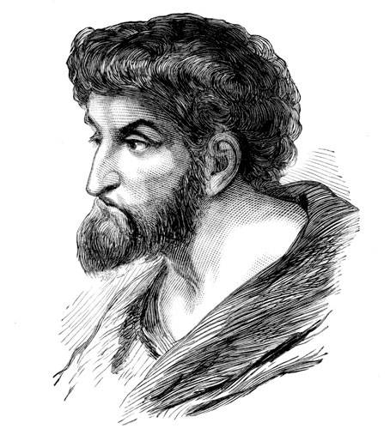
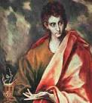
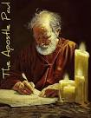
Youth Bible Quiz (Who Was I?) click on the correct letter
Who Was I?
I was a Jew born in Tarsus in Cilicia
I persecuted the church
I was converted on the road to Damascus
.
A. Thomas B. John C. Paul
A. Thomas
B. John
C. Paul
Notes:
M. J. Darby Christian Education Outreach USA 2013 Start as a slide show click on the right letter

Slide 3
The wrong answer, try again. Thomas was the disciple who doubted Jesus; read more about Thomas in John 20:24-28

Slide 4
The wrong answer try again; read more about John in The Gospel of John 20:2

Slide 5
The correct answer read Act 9 and Acts 22 for additional information on the Apostle Paul.

Slide 6
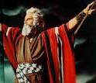
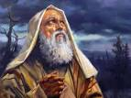
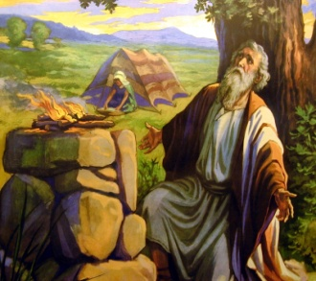
Bible Quiz (Who Am I?) click on the correct letter
I suffered many trials and tribulations
I had a wife, seven sons, and three daughters
I was a rich man who had lots of animals
I am known best for overcoming great suffering
A. Moses
B. Abraham
C. Job
Notes:
M. J. Darby Christian Education Outreach USA 2013 Start as a slide show click on the right letter

Slide 7
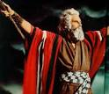
Wrong answer try again Moses is called the lawgiver; read more about Moses in Exodus 2:1-8 , Exodus 20: 1-26

Slide 8
The wrong answer; read more about Abraham in Genesis 11:26, Genesis 12:1-3 Abraham is called the father of the faithful; he was the first man to believe in an unseen God.

Slide 9
Correct answer Job was known as a man of suffering; read more about Job in Job 1:1-6

Slide 10
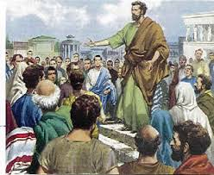
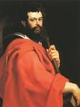
Bible Quiz (Who Am I?) click on the right letter
I was a man full of faith and the Holy Ghost
I stood up for Jesus and spoke boldly of him in the mist
of the Pharisees and Sadducees
When they stoned me, I asked God to have mercy on
them
I was one of the original Deacons
A . Stephen
B . Paul
C. James
Notes:
M. J. Darby Christian Education Outreach USA 2013 Start as a slide show click on the right letter

Slide 11
Right answer Stephen was the first Christian Martyr and he was one of the original Deacons; read more about Stephen in Act 6

Slide 12
The wrong answer try again. Paul was a Pharisee trained at the foot of Gamaliel; he vigorously defended the Jewish faith; he was converted on the Road of Damascus; he wrote 14 of the New Testament books; Paul is considered the first Christian Missionary to the Gentiles read about Paul in Acts 9 and Acts 22

Slide 13
The wrong answer try again. James was a brother to John; they were called the sons of Zebedee James wrote about the tongue; read more about James in Matthew 4:21, 10:2, Mark 5:37
Wrong answer try again James was

Slide 14
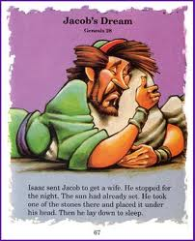
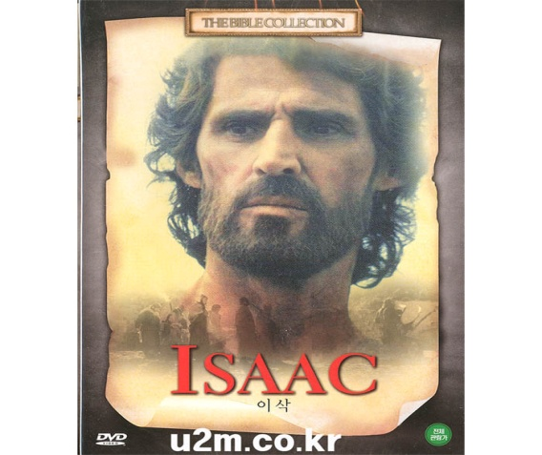
Bible Quiz (Who Am I ?)click on the right letter
I was called the child of promise; my father was a well
known biblical character
I have two sons who were also well-known biblical
characters, one of them wrestled with an angel
A. John the Baptist
B. Jacob
C. Isaac
Notes:
M. J. Darby Christian Education Outreach USA 2013 Start as a slide show click on the right letter

Slide 15
The wrong answer, try again. John the Baptist was the forerunner and cousin of Jesus; he baptized Jesus; read more about John in Luke 1 and Matthew 3:1-15
Wrong answer try again

Slide 16
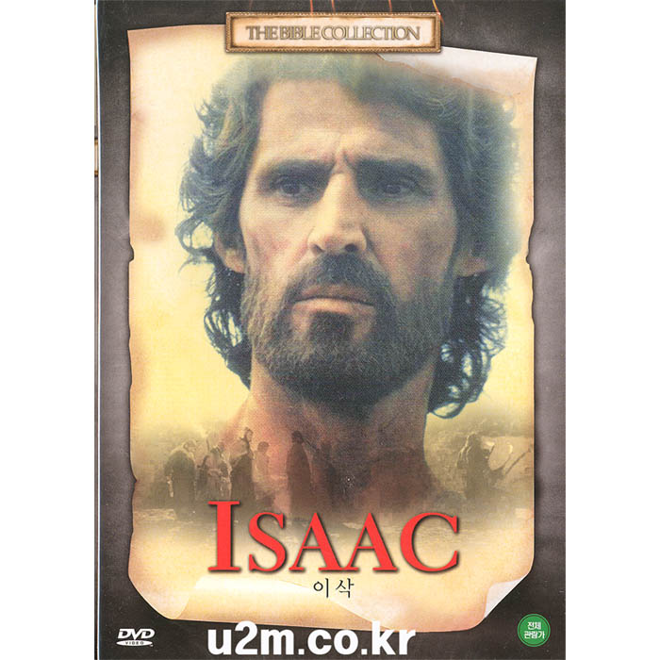
Right answer Isaac was the son of Abraham; he was called the son of promise; read more about Isaac in Genesis 24 and 27Correct

Slide 17
The wrong answer, try again. Jacob was a brother to Esau, and he was the son of Isaac and Rebekah; Jacob tricked his brother Esau into selling his birthright; read more about Jacob in Genesis 25:20-34 The wrong.
Wrong answer try again

Slide 18
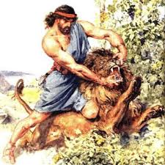
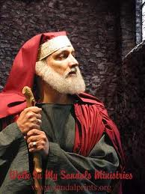
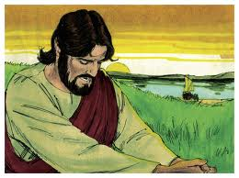
Bible Quiz ( Who am I?) click on the correct letter
I was one of the twelve disciples
I was the son of a fisherman
I am referred to as the disciple whom Jesus loved
A. Samson
B. Nicodemus
C. John
Notes:
M. J. Darby Christian Education Outreach USA 2013 Start as a slide show click on the right letter

Slide 19
The wrong answer; try again. Samson killed a lion with his bare hands; he was blessed with a tremendous amount of strength; he was instructed never to cut his hair; read more about Samson in Judges
13:3-24 and Judge 16:4-22

Slide 20
The wrong answer, try again. Nicodemus asked Jesus what he must do to be born again? Read more about Nicodemus in the third chapter of John

Slide 21
Right answer read more about John in Matthew 4 John wrote the Gospel of John and he wrote the book of Revelation

Slide 22
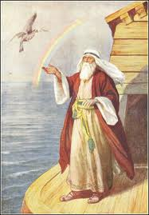
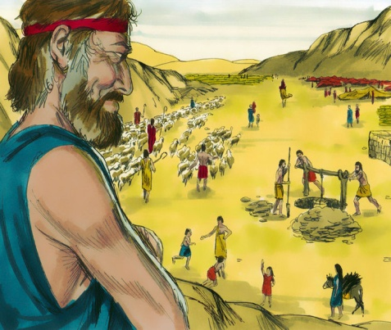
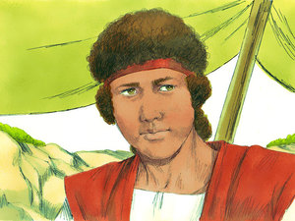
Bible Quiz( Who was I ?) click on the correct letter
The city I lived in was evil and sinful
My uncle was a great Patriarch
The city I lived in was destroyed, and my wife
disobeyed God
A. Noah
B. Lot
C. David
Notes:
M. J. Darby Christian Education Outreach USA 2013 Start as a slide show click on the right letter

Slide 23
The wrong answer, try again. Noah was a righteous man; he lived during a time when the world became evil; God told Noah to build an Ark that would serve as a haven for his family and two of every living thing of all flesh, both male and female; all of the flesh that was not on the ark died in the flood read Genesis 6 and 7 for additional information.

Slide 24
Correct answer Lot was a nephew of Abraham his wife turned into a pillar of salt when she turned and looked back at the city of Sodom and Gomorrah in Genesis 13 and Genesis 19

Slide 25
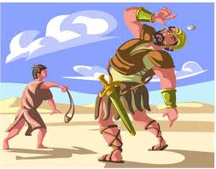
The wrong answer, try again. David was Israel's greatest King; he wrote many of the Psalms, and he slew Goliath when he was a young boy; read more about David in 1 Samuel 16:7-13, Acts 13:22-23, 1 Samuel 17, I Kings 2:11

Slide 26
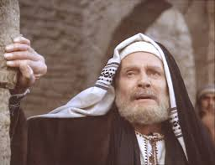
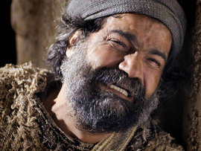
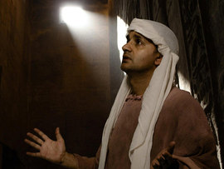
Bible Quiz ( Who was I ?) click on the correct letter
I was a Pharisee and a ruler of the Jews
I came to the master by night, because I was shame to
come by day
I asked a question about the new life
A. Nicodemus
B. Peter
C. Joseph

Slide 27
The correct answer is that Nicodemus was a well-respected teacher of the Pharisees; he asked Jesus what must I do to be born again?; read John 3 for additional information on Nicodemus.

Slide 28
Wrong answer. Try again. Peter was the disciple who said that he would not deny Jesus, yet he denied him three times; Peter was also the disciple who cut off the soldier’s ear in the Garden of Gethsemane, where the Roman soldiers arrested Jesus and Judas betrayed him; read more about Peter in John 1:40-42,
Matthew 4:18, Matthew 26:33-35

Slide 29
The wrong answer; try again. Joseph was called the dreamer; he was sold into slavery. Pharaoh found favor in Joseph and was appointed to a high administrative position; read more about Joseph in Genesis 37.

Slide 30
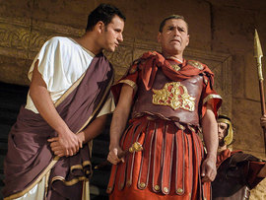
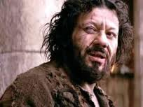
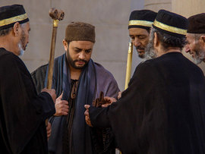
Bible Quiz ( Who was I ?) click on the correct letter
I was a rebel
I burned down Roman cities
I was imprisoned and released for they chose to spare
my life
A, Pontius Pilot
B. Barabbas
C. Judas Iscariot
Notes:
M. J. Darby Christian Education Outreach USA 2013 Start as a slide show click on the right letter

Slide 31
The wrong answer try again Pilot was the Roman governor who approved the condemnation of Jesus; read more about Pontius Pilot in Matthew 27:2, Luke 23:4-6,
John 18:38, 19:4,6

Slide 32
The wrong answer; try again. Judas was one of the 12 disciples; he was the treasurer; he betrayed Jesus and later hanged himself; read.
John 12:3-6 Matthew 26: 22 -28 for additional information

Slide 33
Correct answer Barabbas was a prominent Jewish criminal; the Jewish leaders chose Barabbas over Jesus to be freed and released by the Pilot during the annual pass-over celebration; read more about Barabbas in Matthew 27: 17-26

Slide 34
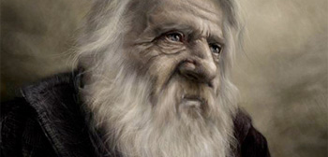
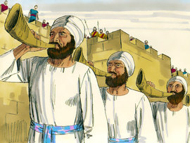
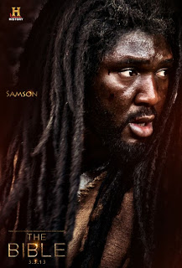
Bible Quiz ( Who was I?) click on the correct letter
I lived 930 years
I named each animal in God's kingdom
Some people say that I caused sin to come into the
world
A . Methuselah
B. Joshua
C . Adam
Notes:
M. J. Darby Christian Education Outreach USA 2013 Start as a slide show click on the right letter

Slide 35
The wrong answer, try again. Joshua was the successor to Moses; he was known for fighting the battle of Jericho; read Joshua 6: 1-27 for additional information.

Slide 36
The wrong answer; try again. Methuselah lived 969 years; read Genesis 5:21-27 for additional information.

Slide 37
Correct answer Adam was the first man, and he was created in the image of God (read more about Adam in Genesis 2:7-21, Genesis 3:17-20, Genesis 5: 3-5)

Slide 38
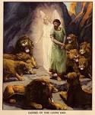
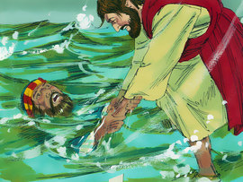
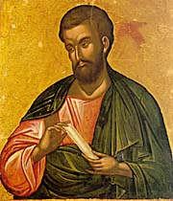
Bible Quiz (Who was I?) click on the correct letter
I was called the forerunner of Jesus Christ
I had disciples
I was the cousin of Jesus Christ
A. Daniel
B. John the Baptist
C. Nathanael Bartholomew
Notes:
M. J. Darby Christian Education Outreach USA 2013 Start as a slide show click on the right letter

Slide 39
The wrong answer, try again. Daniel was a prophet and a government official; he was taken into captivity under the leadership of Babylonian King Nebuchadnezzar, he was cast into a lion’s den; he refused to obey the king’s orders; read more about Daniel in Daniel 5:17-30, 6:11-24

Slide 40
Correct answer John Baptist baptized Jesus; read more about John Baptist in Luke 1 and Matthew 3:1-15

Slide 41
Wrong answer try again Nathaniel Bartholomew was one of the 12 apostles, a lot is not known about Nathaniel Bartholomew; read Matthew 10:3, Mark 3:18, Luke 6:14; Acts 1:13 for additional information

Slide 42
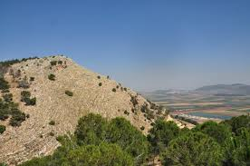
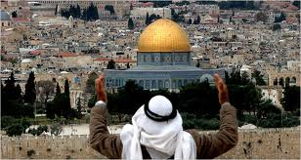
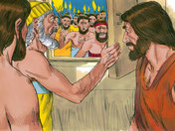
Bible Quiz (Where was I ?) click on the right letter
I was a place where wicked men and women lived
Angels visited me
Fire and brimstone rained down on me
A. Nazareth
B. Jerusalem
C. Sodom and Gomorrah
Notes:
M. J. Darby Christian Education Outreach USA 2013 Start as a slide show click on the right letter

Slide 43
Wrong answer try again Nazareth is a town located north of Jerusalem Jesus grew up in Nazareth; read more about Nazareth in Matthew 2:23

Slide 44
Wrong answer try again Jerusalem was the capital city it was called the city of David; it is considered the center of worship by both Judaism and Islam and read more about Jerusalem in 2 Samuel 5:1-10

Slide 45
Right answer Sodom and Gomorrah was considered a evil wicked city for additional information read Genesis 13:10-12

Slide 46
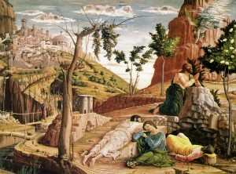
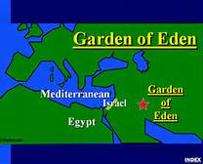
Bible Quiz (Where was I?) click on the right letter
Two trees were planted in the midst of me
I was known as a Paradise
I was a garden
A . The Garden of Gethsemane
B. Sunset Western Garden
C. Garden of Eden

Slide 47
Wrong answer try again the Garden of Gethsemane is where Jesus was betrayed by Judas and arrested by the Roman soldiers for additional information read Mark 14:32

Slide 48
Wrong answer try again the Sunset Western Garden is not a biblical garden

Slide 49
Right answer Eden was the home of Adam and Eve the first man and woman for additional information read Genesis 2:8

Slide 50
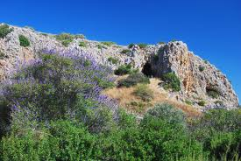
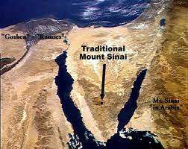
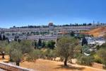
Bible Quiz (Where was I ?)
I am either known as a mountain or as a desert
I became very famous when the Hebrews came out of
Egyptian slavery
A very important event took place on me
A. Mount Carmel
B. Mount Sinai
C. Mount of Olives
Notes:
M. J. Darby Christian Education Outreach USA 2013 Start as a slide show click on the right letter

Slide 51
Wrong answer try again Elijah battled the prophets of Baal on Mount Carmel for additional information read 1 Kings 18:17-40

Slide 52
Right answer the 10 commandments were given to Moses on Mount Sinai read Exodus 19 and 20 for additional information on the 10 commandments and Mount Sinai

Slide 53
Wrong answer try again the Mount of Olives is located in Jerusalem; the scripture says that after Jesus and his disciples observed the Last Supper they sung a hymn and went out into the Mount of Olives read Matthew 26:26-30 for additional information

Slide 54
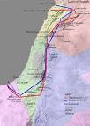
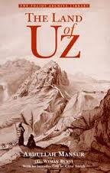
Bible Quiz ( Where was I ?) click on the right letter
I am the place where a very rich man lived
He was said to be one of the richest men who lived in the
East
I am the place where a lot of suffering took place
A. Canaan Land
B The Land of UZ
C. The Land of Goshen
Notes:
M. J. Darby Christian Education Outreach USA 2013 Start as a slide show click on the right letter

Slide 55
Wrong answer According to Wikipedia Canaan is what is called modern day Israel, the Palestinian territories (including Gaza Strip), Lebanon, northwestern Jordan, and some western areas of Syria. Canaan was called the Promised Land read Genesis 17:1-8 for additional information

Slide 56
Right answer the land of Uz was the home of Job read Job 1:1 for additional information

Slide 57
Wrong answer try again the Pharaoh assigned Joseph and his family to live in Goshen Land until their exodus from Egypt read Genesis 47:6 for additional information

Slide 58
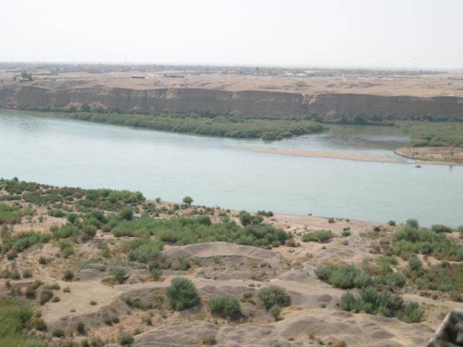
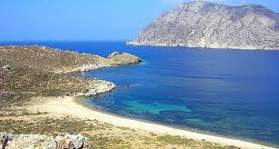
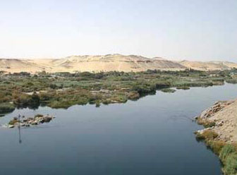
Bible Quiz (Where am I ?) click on the right letter
I am the place of a very important meeting between
Jesus and his cousin
I am a very important body of water
I am the place where Naaman the Leper was healed
A. Euphrates River
B. Jordan River
B. Nile River
Notes:
M. J. Darby Christian Education Outreach USA 2013 Start as a slide show click on the right letter

Slide 59
Wrong answer try again according to Geneses 2:10-17 The Euphrates River is one of four rivers that is cited in the description of Eden read Genesis 2:14 and Daniel 10:4 for further input

Slide 60
Wrong answer try again the Nile is referred to as the River of Egypt read more about the Nile in
Genesis 15:18

Slide 61
Right answer Jesus was baptized in the Jordan River read II Kings 5:10 and Matthew 3:1-6 for additional information

Slide 62
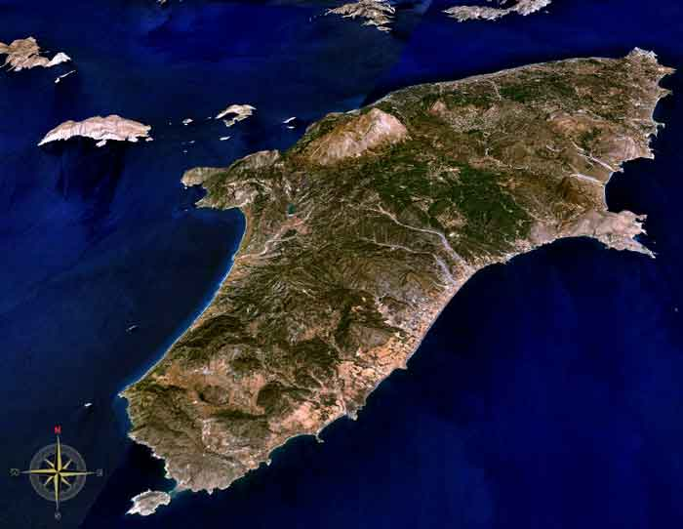
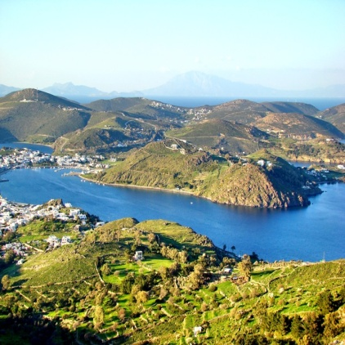
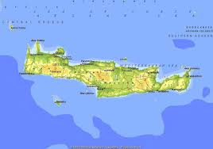
Bible Quiz ( Where was I? click on the right letter
I was an isolated place
I am the place where the beloved disciple of Jesus was
exiled
I am an island
A. The Isle of Rhode
B. The Isle of Patmos
C. The Isle of Crete
Notes:
M. J. Darby Christian Education Outreach USA 2013 Start as a slide show click on the right letter

Slide 63
Wrong answer try again the Isle Rhode is one of the Islands that the apostle passed by during his missionary travels

Slide 64
Right answer The Apostle John wrote the book of Revelation on the Isle of Patmos read Revelation 1:9 for additional information

Slide 65
Wrong answer try again Paul sailed
by the Isle of Crete as a prisoner when he was sailing toward Rome to stand trial before Caesar. The ship broke into several pieces before reaching Rome but Paul and the other prisoners survived they were able to find safety on dry land read Acts 27 and 28 for additional information

Slide 66
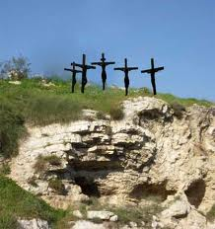
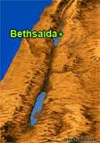
Bible Quiz ( Where was I?) click on the right letter
I am a hill outside of Jerusalem
I am referred to as the place of the skull
Jesus was crucified here
A. Golgotha
B. Bethsaida
C. Nazareth

Slide 67
Right answer Golgotha was a popular Roman execution location read John 19:17 for additional information

Slide 68
Wrong answer try again Bethsaida was located on the Northeastern Shore of the Sea of Galilee Jesus fed the 5 thousand in Bethsaida (Luke 9:10-17)

Slide 69
Wrong answer try again Nazareth was the place where Jesus grew up read Matthew 21:11, John 1:46 for additional information

Slide 70
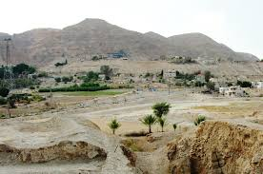
Bible Quiz click (Where was I?) click on the right letter
I am a city and I was conquered by David
Nebuchadnezzar destroyed me
Cyrus rebuilt me
I am perhaps the most famous city in the world
A. Damascus
B. Jericho
C. Jerusalem
Notes:
M. J. Darby Christian Education Outreach USA 2013 Start as a slide show click on the right letter

Slide 71
Wrong answer try again Damascus was the place where the apostle Paul was converted read Acts 9:1-25 for additional information

Slide 72
Wrong answer try again Jesus restored the sight of Bartimaeus in the city of Jericho read
Mark 10 :46-52 for additional insight

Slide 73
Right answer Jerusalem is considered the center of world worship for both Judaism and Islam read
II Samuel 5: 6-7 for additional information on Jerusalem

Slide 74
Bible Quiz (Where was I?) click on the right letter
Rahab lived there
Spies were sent to bring back information
I am the city where a very important battle was fought
A. Cana
B. Jerusalem
C. Jericho
Notes:
M. J. Darby Christian Education Outreach USA 2013 Start as a slide show click on the right letter

Slide 75
Wrong answer try again Cana was the village where Jesus performed his first miracle when he changed water to wine read John 2:1-11 for additional information

Slide 76
Wrong answer try again Jerusalem was the Holy City where all of the great Jewish feasts where held read Luke 2:38-41 for additional information

Slide 77
Right answer read Joshua 2:1-15, and Joshua 6:1-26 for additional information on Jericho

Slide 78
Bible Quiz click ( Where was I?) click on the right letter
I was much traveled in ancient biblical times
I was a very famous road
I am the road that the Apostle Paul was converted on
A. Damascus Road
B. Jericho Road
C. Emmaus Road
Notes:
M. J. Darby Christian Education Outreach USA 2013 Start as a slide show click on the right letter

Slide 79
Wrong answer try again The Jericho Road is where the story of the Good Samaritan took place; read Luke 10:29-37 for additional information

Slide 80
Wrong answer try again Jesus appeared on the Emmaus Road after his crucifixion; read Luke 24:13-35 for additional information

Slide 81
Right answer Paul was converted on the Damascus Road; read Acts 9:3-20 additional information

Slide 82
Bible Quiz (What Am I?) click on the right letter
I was made out of gopher wood
I helped both men and beast find their way to safety
I was rained on for 40 days and 40 nights
A. The Ark of the baby Moses
B. The Ark of the Covenant
C. Noah’s Ark
Notes:
M. J. Darby Christian Education Outreach USA 2013 Start as a slide show click on the right letter

Slide 83
The wrong answer try again Moses’ mother placed him in a small ark and placed the ark in the river to save his life when he was an infant. Pharaoh’s daughter rescued Moses from the ark; read Exodus 2: 1-10 for additional information

Slide 84
Right answer Noah built the ark for a safe haven for his family and other selected living things; read
Genesis 6,7 and 8 for additional information on Noah’s Ark

Slide 85
Wrong answer try again the Ark of the Covenant was a beautiful chest that held the broken tablets of the 10 commandments , the book of the law, manna bread and the Rod of Aaron read Deuteronomy 31:26; Exodus 16:33, Number 17:10 for addition information

Slide 86
Bible Quiz( What am I?) click on the right letter
I was built with brick and stone
The people who built me were very proud
Before I was built the whole earth spoke one language
and of one speech
A . David’s Tower
B. Maya Tower
C. Tower of Babel
Notes:
M. J. Darby Christian Education Outreach USA 2013 Start as a slide show click on the right letter

Slide 87
Wrong answer try again the Tower of David is mentioned in the Song of Solomon 4: 4

Slide 88
Wrong answer try again the Mayan Temple is not a biblical Temple

Slide 89
Right answer The Tower of Babel was destroyed because of man’s pride read more about the Tower of Babel in Genesis 11

Slide 90
Bible Quiz ( What am I ?) click on the right letter
James talked about me
I have caused much joy and lots of pain
I am one of the smallest members of the body, yet I am
very powerful
A. The Tongue
B. Eye
C. The Mouth
Notes:
M. J. Darby Christian Education Outreach USA 2013 Start as a slide show click on the right letter

Slide 91
The right answer read
James 1:26-27 for additional information on the tongue

Slide 92
Wrong answer try again the eye is mention numerous times in the bible read Genesis 3:5-6 for a reference concerning the eyes of Adam and Eve

Slide 93
Wrong answer try again the mouth is mention many times in the bible; read Romans10:9-10 for a very good reference concerning the mouth and salvation

Slide 94
Bible Quiz (What am I?) click on the right letter
I was used by the Roman government
I was a symbol of evil to the Roman government, but a
symbol of hope and salvation to mankind
I have a very distinct shape
A. The Crown of Glory
B. The Cross
C. The sign of the fish
Notes:
M. J. Darby Christian Education Outreach USA 2013 Start as a slide show click on the right letter

Slide 95
Wrong answer try again the fish is used as a sign of evangelism Jesus made many references to fish such as his comments in Matthew 4:19 where he told his disciples that he would make them fishers of men

Slide 96
Right answer the cross was a symbol of pain, suffering, and triumphant, it is through the shedding of blood on the cross that men, women, boys and girls receive salvation through confessing with their mouth and believing in their heart that Jesus Christ is Lord and Savior read more about the cross. In l Corinthians 1:17 and Hebrews 9:11-15

Slide 97
Wrong answer try again the bible talks about a Crown of Glory that will never fade away; read 1 Peter 5:4 for further information

Slide 98
Bible Quiz (What am I?) click on the right letter
I am a symbol of glory
Priests and kings wore me
The bible says the righteous shall receive me when the
chief shepherd appears
A . White Robe
B. The Rose of Sharon
C The Crown of Glory
Notes:
M. J. Darby Christian Education Outreach USA 2013 Start as a slide show click on the right letter

Slide 99
Wrong answer try again the bible refers to robes that were made white when they were washed in the blood of the lamb; the lamb is a reference to Jesus Christ read Revelation 7:14 for further information

Slide 100
Wrong answer try again the Song of Solomon 2:1 says “I am the rose of Sharon and the Lilly of the valleys.” The rose is a symbol of love and beauty

Slide 101
Right answer read more about the crown in I Corinthians 9:25;
I Peter 5:4; II Timothy 4:8 The Bible refers to the Crown of Glory, the Crown of Life, and the Crown of righteousness. A Crown symbolize the final reward of all Christians

Slide 102
Bible Quiz (What am I?) click on the right answer
I serve a very important function in Christian worship
The disciples observed me
I am known by two very distinct symbols
A. Sacrifice Offering
The Lord’s Supper
C. Baptism
Notes:
M. J. Darby Christian Education Outreach USA 2013 Start as a slide show click on the right letter

Slide 103
Wrong answer try again the Old Testament sacrificial system was a system of Atonement for sin. Men, Women, boys and girls no longer need an earthly priest to make intercession all believers have a mediator in Jesus Christ. It is through the blood sacrifice of Jesus that we are purged of our sins; read Leviticus 17:11, Hebrews 9:13-14 for further information

Slide 104
Right answer read about the Lord's Supper in 1 Corinthians11:20-29. Jesus said that believers should observe the Lord’s Supper on a regular basis

Slide 105
Wrong answer try again Baptism symbolized dying to sin and rising to a new life in Jesus Christ read
John 1:26-33 and Mark 1:9-11

Slide 106
Bible Quiz (What am I?) click on the right letter
I am an ancient ceremony
I symbolize the new life
A man in the wilderness performed me
A. The Lord’s Supper
B. The Institution of Marriage
C. Baptism
Notes:
M. J. Darby Christian Education Outreach USA 2013 Start as a slide show click on the right letter

Slide 107
Wrong answer try again the bread in the Lord’s supper symbolized the broken body of Jesus and the wine symbolized the blood of Jesus that was shed on the cross for
the forgiveness of sin read 1 Corinthians 11:27-32 for additional insight

Slide 108
Wrong answer try again Marriage is the oldest institution on earth the bible says in Matthew 19:5-6 that man should leave his father and mother and shall cleave to his wife and they twain shall become one. Those who are in a true Christian marriage are protected against sexual diseases and are in an environment where children can be properly nurtured; Marriage is between a Man and a Woman

Slide 109
Right answer Jesus gave the great commission in Matthew 28: 18-20 he says :All power is given unto me in heaven and earth Go ye therefore and teach all nations , baptizing them in the name of the Father and of the Son and the Holy Ghost Teaching them to observe all things whatsoever I have commanded you: and, lo I am with you always even unto the end of the world read more about Baptism in Mark 1:1-5

Slide 110
Bible Quiz( What am I?) click on the right letter
I have caused a lot of pain and heartache
I am universal, everyone is affected by me
I cause people to feel guilty
A. The Javelin
B. Sin
C. Judgment
Notes:
M. J. Darby Christian Education Outreach USA 2013 Start as a slide show click on the right letter

Slide 111
Wrong answer try again a Javelin was a symbol of war King Saul casted a Javelin toward David in a fit of rage read about the incident in
1 Samuel 18: 6-12

Slide 112
Right answer Sin is disobeying or falling short of the standard of God the standard of God are his laws, commandments and percepts; read more about sin in Genesis 3:1-24 , Romans 3:23 and Psalms 51:5

Slide 113
Wrong answer try again The judgment of God is universal Philippians 2: 10 says “That at the name of Jesus every knee should bow, of things in heaven, and things in earth, and things under the earth 11 And that every tongue should confess that Jesus Christ is Lord to the glory of God and the Father

Slide 114
Bible Quiz (What am I?) click on the right letter
I bring people together
Jesus constantly talked about me
I am discussed in John 3:16
A. The Lord’s Supper
B The Sign of the fish
C. The Lord’s Prayer
Notes:
M. J. Darby Christian Education Outreach USA 2013 Start as a slide show click on the right letter

Slide 115
Wrong answer try again Christians observe Sunday as the Lord’s Day; Sunday was the day Jesus arose from the dead

Slide 116
Right answer Jesus encouraged his followers to love one another read
I Corinthians 13
for additional insight on love

Slide 117
Wrong answer try again The Lord’s Prayer is referred to as the model prayer the first section of the prayer acknowledges God as the father; the second section of prayer request that our physical needs be met, the third section of the prayer request that our spiritual needs be met; read Matthew 6: 9-13 for further information on the prayer

Slide 118
Bible Quiz (What am I?) click on the right letter
I am a product of the Love
People who possess me are better equipped to live the
Christian life
Paul discussed me in Galatians
A. The Fruit of the Spirit
B. The Holy Spirit
C. Salvation
Notes:
M. J. Darby Christian Education Outreach USA 2013 Start as a slide show click on the right letter

Slide 119
Right answer The Fruit of the Spirit are the characteristics and qualities of Jesus Christ; read more the fruit of the Spirit in Galatians 5:22-25

Slide 120
Wrong answer try again The Holy Spirit is the spirit of Jesus Christ, The Holy Spirit is the source of all of the spiritual gifts read John 14:16-19; 26-31 for further insight

Slide 121
Wrong answer try again Salvation is the most essential gift of all human beings the bible says that we will all spend eternity some where either in heaven or hell. John 3: 16 says “For God so loved the world , that he gave his only begotten Son , that whosoever believeth in him should not perish, but have everlasting life”. Roman’s 10:9 says “That if thou shalt confess with thy mouth the Lord Jesus, and shalt believe in thine heart that God hath raised him from the dead thou shalt be saved”

Slide 122
This ends the Bible Quiz. The information credits are listed on slides 123 through 136. Please review each of the first 122 slides for valuable scripture information. For further resources, contact Reverend Micheal J. Darby at 910 352-8943, or send an email to: jonah68@gmail.com

Slide 123
Scripture Credits
Kings Bible Nelson Press Nashville, Tennessee 1976
Dockrey Karen, Godwin, Johnnie and Phyllis The Student Bible
Dictionary Holman Bible Publishers 1993
Martin William C The Layman’s Bible Encyclopedia, The
Southwestern Company Nashville, Tennessee 1964
Image Credits
Thomas
http://www.bing.com/images/search?q=Thomas+of+the+bible&qs=n&form=QBIR&pq=thomas+of+the+bible&sc=8-19&sp=-1&sk=
John
http://www.bing.com/images/search?q=John+of+the+bible&qs=n&form=QBIR&pq=john+of+the+bible&sc=8-17&sp=-1&sk=
Paul
http://struckbygrace.files.wordpress.com/2011/02/apostle-paul.jpg
Moses
http://www.bing.com/images/search?q=+Moses+of+the+bible&qs=n&form=QBIR&pq=moses+of+the+bible&sc=8-18&sp=-1&sk=

Slide 124
Image Credits
Job
http://www.bing.com/images/search?q=job+of+the+Bible&qs=n&form=QBIR&pq=job+of+the+bible&sc=0-0&sp=-1&sk=
Stephen
http://www.bing.com/images/search?q=Stephen+of+the+Bible&qs=n&form=QBIR&pq=stephen+of+the+bible&sc=8-20&sp=-1&sk=
Paul
http://www.bing.com/images/search?q=Paul++of+the+Bible&qs=n&form=QBIR&pq=paul+of+the+bible&sc=8-17&sp=-1&sk=
James
http://www.bing.com/images/search?q=James+of+the+bible&qs=n&form=QBIR&pq=james+of+the+bible&sc=8-18&sp=-1&sk=
John the Baptist
http://www.bing.com/images/search?q=john+the+baptist&qs=AS&sk=&FORM=QBIR&pq=john%20the%20baptit&sc=8-15&sp=1&qs=AS&sk=
Jacob
http://www.bing.com/images/search?q=Jacob+of+the+bible&qs=n&form=QBIR&pq=jacob+of+the+bible&sc=8-18&sp=-1&s

Slide 125
Image Credits
Isaac
http://www.bing.com/images/search?q=Isaac++of+the+Bible&qs=n&form=QBIR&pq=isaac+of+the+bible&sc=8-18&sp=-1&sk=
Samson
http://www.bing.com/images/search?q=Samson++of+the+Bible&FORM=HDRSC2
John
http://www.bing.com/images/search?q=Saint+John++of+the+Bible&qs=n&form=QBIR&pq=saint+john+of+the+bible&sc=8-23&sp=-1&sk=
Noah
http://www.bing.com/images/search?q=Noah+of+the+bible&qs=n&form=QBIR&pq=noah+of+the+bible&sc=8-17&sp=-1&sk=
Lot
http://search.babylon.com/?q=Bible+Lot&s=img&rlz=0&babsrc=HP_Prot
David
http://www.bing.com/images/search?q=David+of+the+bible&qs=n&form=QBIR&pq=david+of+the+bible&sc=8-18&sp=-1&sk=#a

Slide 126
Image Credits
Nicodemus
http://www.bing.com/images/search?q=nicodemus&qs=PA&sk=&FORM=QBIR&pq=nicodemis&sc=8-9&sp=1&qs=PA&sk=
Peter
http://search.babylon.com/?q=Peter+of+the+Bible&s=img&rlz=0&babsrc=HP_Prot
Joseph
http://www.bing.com/images/search?q=Joseph+of+the+Bible&qs=n&form=QBIR&pq=joseph+of+the+bible&sc=8-19&sp=-1&sk=
Pontius Pilot
http://www.bing.com/images/search?q=Pontius+Pilot&qs=n&form=QBIR&pq=pontius+pilot&sc=8-13&sp=-1&sk=
Barabbas
http://www.bing.com/images/search?q=+Barabbas+of+the+Bible&qs=n&form=QBIR&pq=barabbas+of+the+bible&sc=6-21&sp=-1&sk=#view=
Judas Iscariot
http://www.bing.com/images/search?q=Judas+Iscariot&qs=n&form=QBIR&pq=judas+iscariot&sc=8-14&sp=-1&sk=

Slide 127
Image Credits
Methuselah
http://www.bing.com/images/search?q=Methuselah+of+the+Bible&qs=n&form=QBIR&pq=methuselah+of+the+bible&sc=5-23&sp=-1&sk=
Joshua
http://www.bing.com/images/search?q=+Joshua+of+the+Bible&qs=n&form=QBIR&pq=joshua+of+the+bible&sc=8-19&sp=-1&sk=
Adam
http://www.bing.com/images/search?q=the+biblical+adam&qs=HS&form=QBIR&pq=&sc=8-0&sp=2&sk=HS1
Nazareth
http://www.bing.com/images/search?q=Nazareth+of+the+Bible&qs=n&form=QBIR&pq=nazareth+of+the+bible&sc=7-21&sp=-1&sk=
Jerusalem
http://www.bing.com/images/search?q=Jerusalem+of+the+Bible&qs=n&form=QBIR&pq=jerusalem+of+the+bible&sc=8-22&sp=-1&sk=
Sodom and Gomorrah
http://www.bing.com/images/search?q=+Sodom+and+Gomorrah+of+the+Bible&qs=n&form=QBIR&pq=sodom+and+gomorrah+of+the+bible&sc

Slide 128
Image Credits
The Garden of Gethsemane
http://www.bing.com/images/search?q=The+Garden+of++Gethsemane&go=&qs=bs&form=QBIR
Sunset Western Garden
http://www.bing.com/images/search?q=Sunset+Western+Garden&qs=n&form=QBIR&pq=sunset+western+garden&sc=8-21&sp=-1&sk=
Garden of Eden
http://www.bing.com/images/search?q=Garden+of+Eden&qs=n&form=QBIR&pq=garden+of+eden&sc=8-14&sp=-1&sk=
Cannon Land
http://www.bing.com/images/search?q=+Canaan++Land&qs=n&form=QBIR&pq=canaan+land&sc=8-11&sp=-1&sk=
The Land of UZ
http://www.bing.com/images/search?q=Bible+Land+of+UZ&qs=n&form=QBIR&pq=bible+land+of+uz&sc=1-16&sp=-1&sk=
The Land of Goshen
http://www.bing.com/images/search?q=The+Land+of+Goshen&qs=n&form=QBIR&pq=the+land+of+goshen&sc=7-18&sp=-1&sk=

Slide 129
Image Credits
The Isle of Rhode
http://www.bing.com/images/search?q=The+Isle+of+Rhode&qs=n&form=QBIR&pq=the+isle+of+rhode&sc=3-17&sp=-1&sk=
The Isle of Patmos
http://search.babylon.com/?q=The+Isle+of++Patmos&babsrc=HP_Prot&s=img&rlz=0&as=0&ac=0
The Isle of Crete
http://www.bing.com/images/search?q=the%20isle%20of%20crete&pc=conduit&ptag=AFF8FCD07ACE04DD0A6F&form=CONTLB&conlogo=CT3210127&ShowAppsUI=1
Tigris River
http://www.bing.com/images/search?q=Tigris+River&qs=n&form=QBIR&pq=tigris+river&sc=8-12&sp=-1&sk=
Jordan River
http://www.bing.com/images/search?q=Jordan+River+Israel+Map&FORM=RESTAB
Nile River
http://www.bing.com/images/search?q=Nile++River&go=&qs=bs&form=QBIR

Slide 130
Image Credits
Golgotha
http://www.bing.com/images/search?q=Golgotha&qs=n&form=QBIR&pq=golgotha&sc=8-8&sp=-1&sk=Golgotha
Bethsaida
http://www.bing.com/images/search?q=bethsaida+israel&qs=IM&form=QBIR&pq=bethsaida&sc=8-9&sp=3&sk=IM2
Nazareth
http://www.bing.com/images/search?q=nazareth&go=&qs=bs&form=QBIR
Damascus
http://www.bing.com/images/search?q=Damascus&FORM=HDRSC2
Jericho
http://www.bing.com/images/search?q=Jericho&qs=n&form=QBIR&pq=jericho&sc=8-7&sp=-1&sk=
Jerusalem
http://www.bing.com/images/search?q=Jerusalem&qs=n&form=QBIR&pq=jerusalem&sc=8-9&sp=-1&sk=

Slide 131
Image Credits
Cana
http://www.bing.com/images/search?q=Cana&qs=n&form=QBIR&pq=cana&sc=8-4&sp=-1&sk=
Mount Carmel
http://www.bing.com/images/search?q=Mount+Carmel&qs=n&form=QBIR&pq=mount+carmel&sc=8-12&sp=-1&sk=
Mount Sinai
http://www.bing.com/images/search?q=Mount+Sinai+&qs=n&form=QBIR&pq=mount+sinai+&sc=8-12&sp=-1&sk=
Mount of Olives
http://www.bing.com/images/search?q=Mount++of+Olives&qs=n&form=QBIR&pq=mount+of+olives&sc=8-15&sp=-1&sk=
Golgotha
http://www.bing.com/images/search?q=Golgotha&qs=n&form=QBIR&pq=golgotha&sc=8-8&sp=-1&sk=
Bethsaida
http://www.bing.com/images/search?q=Bethsaida&qs=n&form=QBIR&pq=bethsaida&sc=8-9&sp=-1&sk=

Slide 132
Image Credits
Nazareth
http://www.bing.com/images/search?q=Nazareth&qs=n&form=QBIR&pq=nazareth&sc=8-8&sp=-1&sk=
Jericho Road
http://www.bing.com/images/search?q=+Jericho+Road&qs=n&form=QBIR&pq=jericho+road&sc=8-12&sp=-1&sk=
Damascus Road
http://www.bing.com/images/search?q=Damascus+Road&qs=n&form=QBIR&pq=damascus+road&sc=8-13&sp=-1&sk=
Emmaus Road
http://www.bing.com/images/search?q=Emmaus+Road&qs=n&form=QBIR&pq=emmaus+road&sc=8-11&sp=-1&sk=
The Ark of the baby Moses
http://www.bing.com/images/search?q=The+Ark+of+the+baby+Moses&qs=n&form=QBIR&pq=the+ark+of+the+baby+moses&sc=0-0&sp=-1&sk=
The Ark of the Covenant
http://www.bing.com/images/search?q=The++Ark+of+the+Covenant&qs=n&form=QBIR&pq=the+ark+of+the+covenant&sc=8-23&sp=-1&sk=

Slide 133
Image Credits
Noah’s Ark
http://www.bing.com/images/search?q=+Noah%E2%80%99s++Ark&qs=n&form=QBIR&pq=noah%E2%80%99s+ark&sc=8-10&sp=-1&sk=
David’s Tower
http://www.bing.com/images/search?q=David%E2%80%99s+Tower&qs=n&form=QBIR&pq=david%E2%80%99s+tower&sc=4-13&sp=-1&sk=
Maya Tower
http://www.bing.com/images/search?q=Maya+Tower&qs=n&form=QBIR&pq=maya+tower&sc=8-10&sp=-1&sk=
Tower of Babel
http://www.bing.com/images/search?q=Tower+of+Babel&qs=n&form=QBIR&pq=tower+of+babel&sc=8-14&sp=-1&sk=
The Tongue
http://www.bing.com/images/search?q=taming+the+tongue&qs=n&form=QBIR&pq=taming+the+tongue&sc=8-17&sp=-1&sk=
The Mouth
http://www.bing.com/images/search?q=mouth&qs=n&form=QBIR&pq=mouth&sc=8-5&sp=-1&sk=

Slide 134
Image Credits
The eye
http://www.bing.com/images/search?q=the+eye&qs=n&form=QBIR&pq=the+eye&sc=8-7&sp=-1&sk=
The Crown of Glory
http://www.bing.com/images/search?q=The+Crown+of+Glory&qs=n&form=QBIR&pq=the+crown+of+glory&sc=8-18&sp=-1&sk=
The Cross
http://www.bing.com/images/search?q=The+Cross&qs=n&form=QBIR&pq=the+cross&sc=8-9&sp=-1&sk=
The sign of the fish
http://www.bing.com/images/search?q=The+sign+of+the+fish&qs=n&form=QBIR&pq=the+sign+of+the+fish&sc=3-20&sp=-1&sk=
White Robe
http://www.bing.com/images/search?q=White+Robe&qs=n&form=QBIR&pq=white+robe&sc=8-10&sp=-1&sk=
The Rose of Sharon
http://www.bing.com/images/search?q=The++Rose+of+Sharon&qs=n&form=QBIR&pq=the+rose+of+sharon&sc=8-18&sp=-1&sk=

Slide 135
Image Credits
The Crown of Glory
http://www.bing.com/images/search?q=The+Crown+of++Glory&qs=n&form=QBIR&pq=the+crown+of+glory&sc=8-18&sp=-1&sk=
A. Sacrifice Offering
http://www.bing.com/images/search?q=A.+Sacrifice+Offering&qs=n&form=QBIR&pq=a.+sacrifice+offering&sc=0-0&sp=-1&sk=
The Lord’s Supper
http://www.bing.com/images/search?q=The+Lord%E2%80%99s+Supper&qs=n&form=QBIR&pq=the+lord%E2%80%99s+supper&sc=8-17&sp=-1&sk=
Baptism
http://www.bing.com/images/search?q=Baptism&qs=n&form=QBIR&pq=baptism&sc=8-7&sp=-1&sk=
Marriage
http://cdn1.russellmoore.com/2013/05/wedding-rings.jpg
The Javelin
http://www.bing.com/images/search?q=spears+and+javelins&qs=n&form=QBIR&pq=spears+and+javelins&sc=0-13&sp=-1&sk=

Slide 136
Image Credits
Sin
http://www.bing.com/images/search?q=+Sin&qs=n&form=QBIR&pq=sin&sc=8-3&sp=-1&sk=
Judgment
http://www.bing.com/images/search?q=Judgment&qs=n&form=QBIR&pq=judgment&sc=8-8&sp=-1&sk=
The Lord’s Day
http://www.bing.com/images/search?q=The+Lord%E2%80%99s+Day&qs=n&form=QBIR&pq=the+lord%E2%80%99s+day&sc=8-14&sp=-1&sk=
The Fruit of the Spirit

