Slide 1
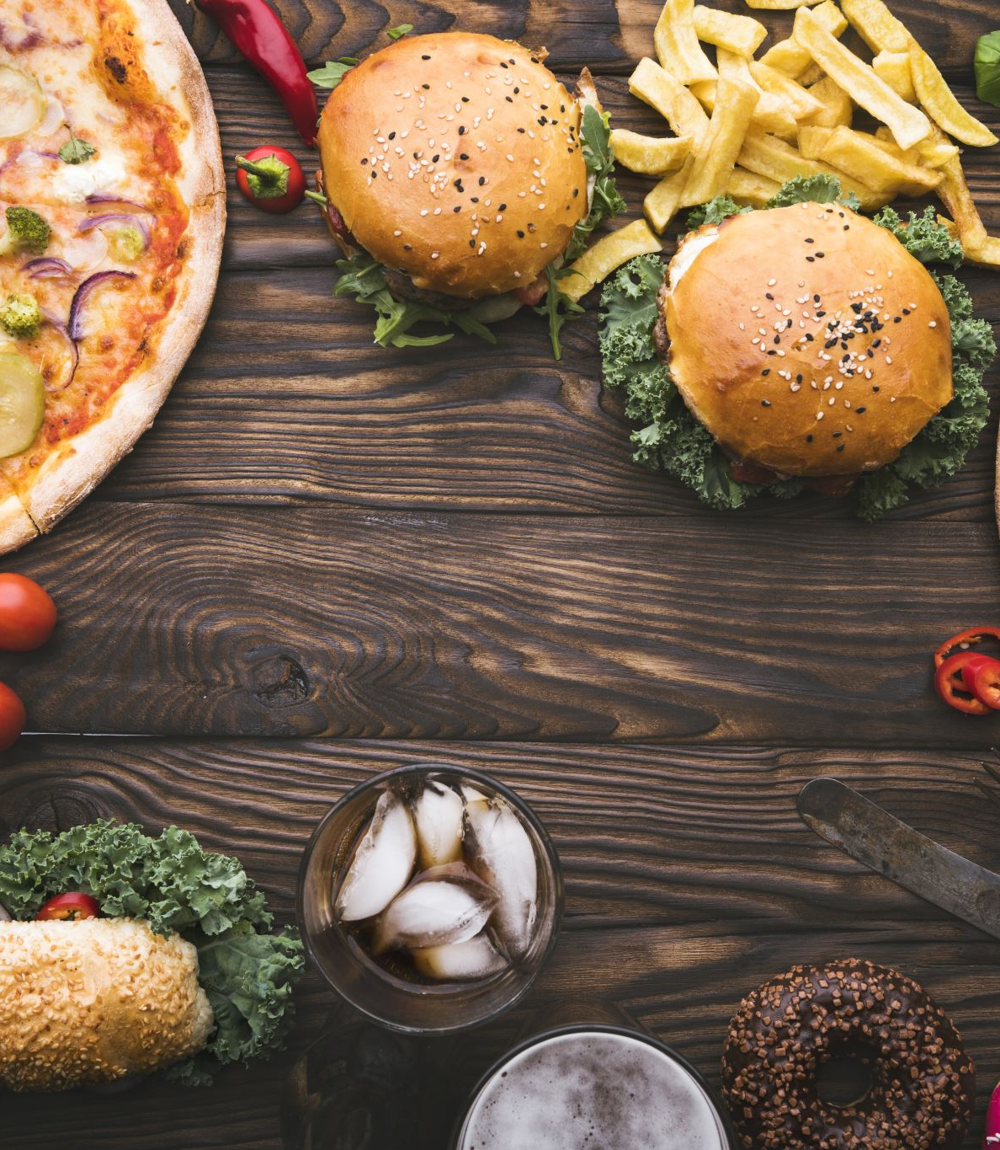
Making the right choices when it comes to food
Micheal J. Darby (jonah68@gmail.com) 2023

Slide 2
The Abuse of Food
You eat food that tastes good but
disagrees with you; what should be your
response?
A. Continue to eat the same food
because the taste of the food out
ways the pain and discomfort
that is caused by eating the food.
B. Stop eating the food if it causes
pain and discomfort.
C. Eat the food now and then.

Slide 3
Wrong Answer
Eat the food now and then.
Continue to take a risk and eat the food because it tastes good is also a bad idea. Stop eating the food altogether or do some research and find out what is causing the pain or discomfort is the best option.

Slide 4
Wrong Answer
You eat food that tastes good
but disagrees with you.
The food usually causes you
pain and discomfort, what
should be your response?
Wrong answer
Continue to eat the same food because of the taste of the food.

Slide 5
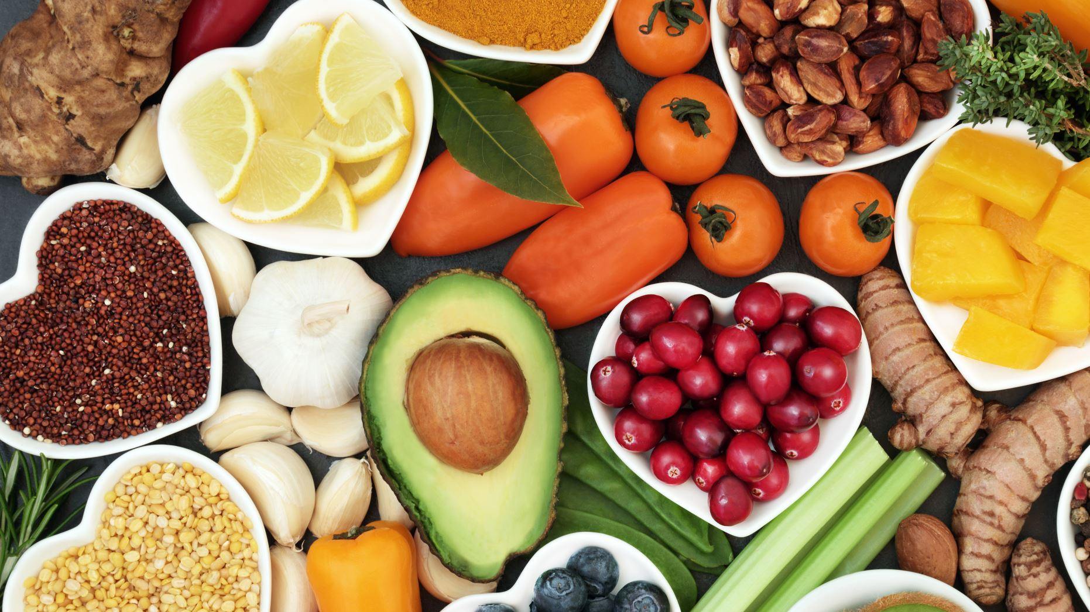
Right Answer
The right answer Stop eating
the food.
Eating disagreeable foods now and then should not be an option. A little bit of food that causes pain and discomfort could lead to significant health issues. Continuing to take a risk and eat the food because it tastes good is also a bad idea. Stop eating the food altogether or do some research and find out what is causing the pain or discomfort is the best option.

Slide 6
It is a hamburger, a hotdog, a bag of potato chips, and a soda; you never change your diet; what should be your response?
A. Drink sodas, eat hamburgers,
hotdogs and potato chips on a
regular basis.
B. If the food tastes good, eat it,
don’t be concerned about what
you eat.
C. Eat a balanced diet because
our bodies need a variety of
vitamins and nutrients to function
properly.

Slide 7
Right answer
Eat a balanced diet; our bodies need a variety of vitamins and nutrients to function correctly.
There is a story of a young lady who ate a steady diet of potato chips, hot dogs, and sodas for most of her early life and well into her adult life; when she reached the age of fifty, she suffered a variety of problems; Kidney failure was one of them. Inability to eat a proper diet and drink enough water probably caused Kidney failure.

Slide 8
Wrong answer
If it tastes good, eat it, do
not worry about what you
eat.
Eating a balanced diet is extremely important. Hamburgers, Hot dogs, Potato chips, and sodas are good when mixed with a balanced diet.

Slide 9
Wrong answer
It is a hamburger, a hotdog, a bag of potato chips, and a soda; you never change your diet; what should be your response?
Eat the same thing. I am in good health; there appear to be no adverse effects.

Slide 10
Energy Products are being advertised all of the time, I need some extra energy, and I do not see any harm in buying over-the-counter energy products; what should be my response?
A. Energy drinks are safe because they
are advertised on television all of
the time.
B. Energy drinks are good for you; they
are packed with vitamins.
C. The best way to be energized is to
, exercise, eat a proper diet and get
enough rest.

Slide 11
Right answer
The best way to be energized is to exercise, eat a proper diet and get enough rest.
Assuming that all energy products are safe is a significant mistake. Sufficient research has not been done on energy drinks to determine the long-term health effects of excessive consumption of energy products.
A person should not believe that a product is suitable for you because it is packed with vitamins and nutrients. Perhaps the best way to be energized is to get enough exercise, eat a balanced diet, and get plenty of sleep, rest, and relaxation.

Slide 12
Wrong answer
Energy drinks are good for you; they are packed with vitamins.
Sufficient research has not been done on energy drinks to determine the long-term health effects of excessive consumption of energy products.

Slide 13
Wrong answer
Energy Products are being advertised all of the time; I need some extra energy; I do not see any harm in buying over-the-counter energy products; what should be my response?
Energy drinks are safe; they are advertised on television all of the time.
Assuming that all energy products are safe is a significant mistake.

Slide 14
I am eating a proper diet, getting enough rest, relaxation, and exercise; yet I am losing an excessive amount of weight, what should be my response?
A. Ignore the symptoms, weight
Fluctuates up and down.
B. Losing weight is a good thing
there is no problem.
C. To be on the safe side consult
with a Health Care Provider to
put your mind at rest.

Slide 15
Wrong answer
Losing weight is a good thing; there is no problem.
Sudden weight loss or excessive weight loss can be a symptom of a significant health issue.

Slide 16
Wrong answer
I am eating a proper diet, getting enough rest, and exercising regularly, yet I am losing an excessive amount of weight; what should be my response?
Ignore the symptoms of weight loss because weight tends to fluctuate up and down.
To be on the safe side, get yourself checked by a Health Care Provider just to put your mind at rest, and it may save your life.

Slide 17
Right answer
If you are losing weight rapidly, get yourself checked by a Healthcare Provider; it may save your life.
Ignoring excessive weight loss is not a good idea. Sudden weight loss or excessive weight loss can be a symptom of a significant health issue.

Slide 18
You are concerned about gaining weight, yet you are not doing anything to address the problem, what are your two responses?
A. Continue to eat anything you want after
all the food taste good and you feel
good.
B. Exercise and maintain the same diet.
C. Change your lifestyle eat a balanced diet,
exercise, get enough sleep and
relaxation, drink lots of water and be
consistent in what you do because no
diet or exercise plan will work if you are
not consistent.

Slide 19
Wrong Answer
Continue to eat anything you want after all the food tastes good, and you feel
good.

Slide 20
Wrong Answer
Exercise and maintain the same diet.

Slide 21
Right Answer
Change your lifestyle eat a balanced diet,
exercise, get enough sleep and
relaxation, drink lots of water, and be
consistent in what you do because no
diet or exercise plan will work if you are
not consistent.

Slide 22
After 9 pm you are hungry you desire to eat some food, what should be your response?
A. Make no exceptions. Eat as
much as you want.
B. Refuse to eat and go to bed hungry.
C. If you are going to eat after
7 pm, eat something light such
as fruit or drink some water or
follow your Health Care
Providers recommendations.

Slide 23
Right Answer
If you are going to eat after
7 pm, eat something light such
as fruit or drink some water or
follow your Health Care
Providers recommendations.

Slide 24
Wrong Answer
Make no exceptions. Eat as
much as you want.

Slide 25
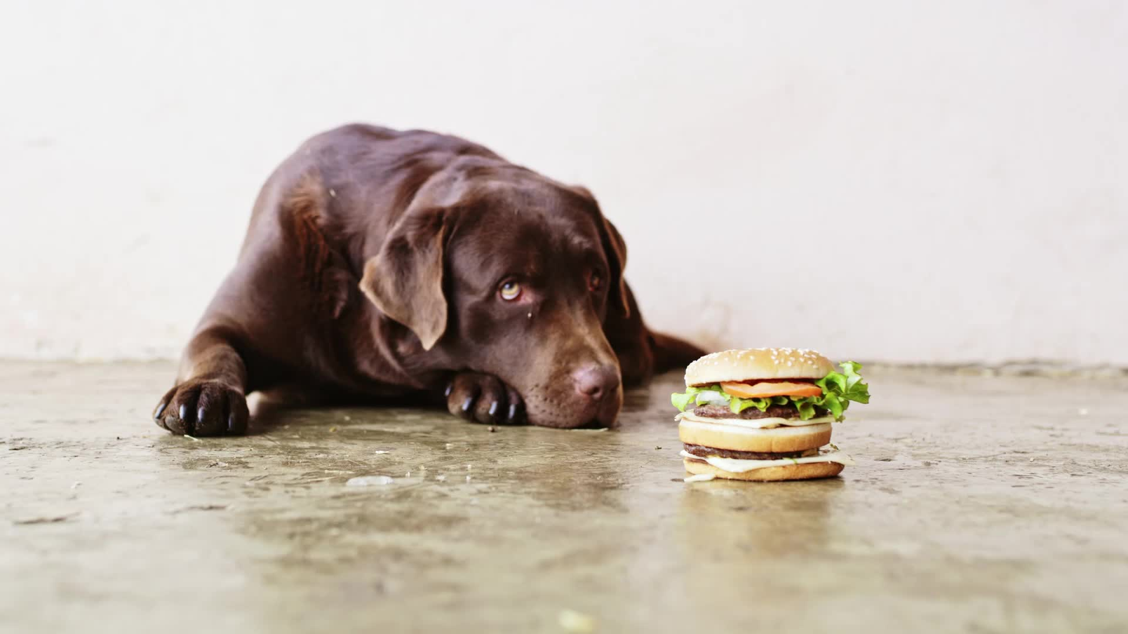
Wrong Answer ( however it may an option for some)
Refuse to eat and go to bed hungry

Slide 26
Right answer
Talk with a trusted friend or trusted adult to develop a strategy to address your feelings of despair; all feelings of loneliness and sadness should be addressed; compulsive eating is not the answer.
Refusing to eat food or drink water when lonely or depressed is not the best option. Most people need vitamins and nutrients for health and strength. Excessive eating can also be harmful. Overeating can lead to significant health issues that may cause sleeplessness, bloating, pain, or discomfort. The best option is to talk with a trusted friend or a trusted adult to develop a strategy to address the feelings of loneliness or despair. Compulsive eating or refusing to eat or drink is not a favorable option.

Slide 27
Wrong answer
You are lonely or depressed the first thing you think about is food; what should be your response?
Eat as much food as you would like to relieve your feelings of loneliness.

Slide 28
A person eats a lot of food, and within a short period, they retreat to the restroom and purge the food up; what a proper response to the problem is?
A. Don’t tell anyone there is no
major problem.
B. It is a temporary phase it will
pass without intervention.
C. Share your concerns with your
parents; seek professional help
it could save your life.

Slide 29
Wrong Answer
Don’t tell anyone there is no
major problem.

Slide 30
Wrong answer
It is a temporary problem; it will pass without intervention.

Slide 31
Right answer
Share your concerns with your parents and seek professional help; it could save your life.
A failure to tell a trusted, responsible person about an eating and purging problem can be deadly. Various issues need to be shared with others. Some problems are too large or too complex to solve on our own. Believing that the problem is temporary and will pass away without intervention can be devastating.
Some problems will not automatically disappear. Making a trusted parent or friend aware of the problem is the first step to addressing it. It is essential to seek professional help if it is severe. Various eating disorders can lead to organ failure or death.

Slide 32
Wrong Answer
A person over eats, and within a short period, they retreat to the restroom to purge the food up; what is a proper response to the problem?
Don’t tell anyone; it will cause significant problems.

Slide 33
If you are lonely and depressed, you turn to excessive eating what should be your response?
A. Don’t tell anyone to avoid drawing attention to yourself
B. It is a temporary problem it will pass with no intervening
C. Tell a trusted parent or school counselor to seek professional help it
needed or recommend

Slide 34
Right Answer
Tell a trusted parent or school counselor to seek professional help it needed or recommend.

