Slide 1
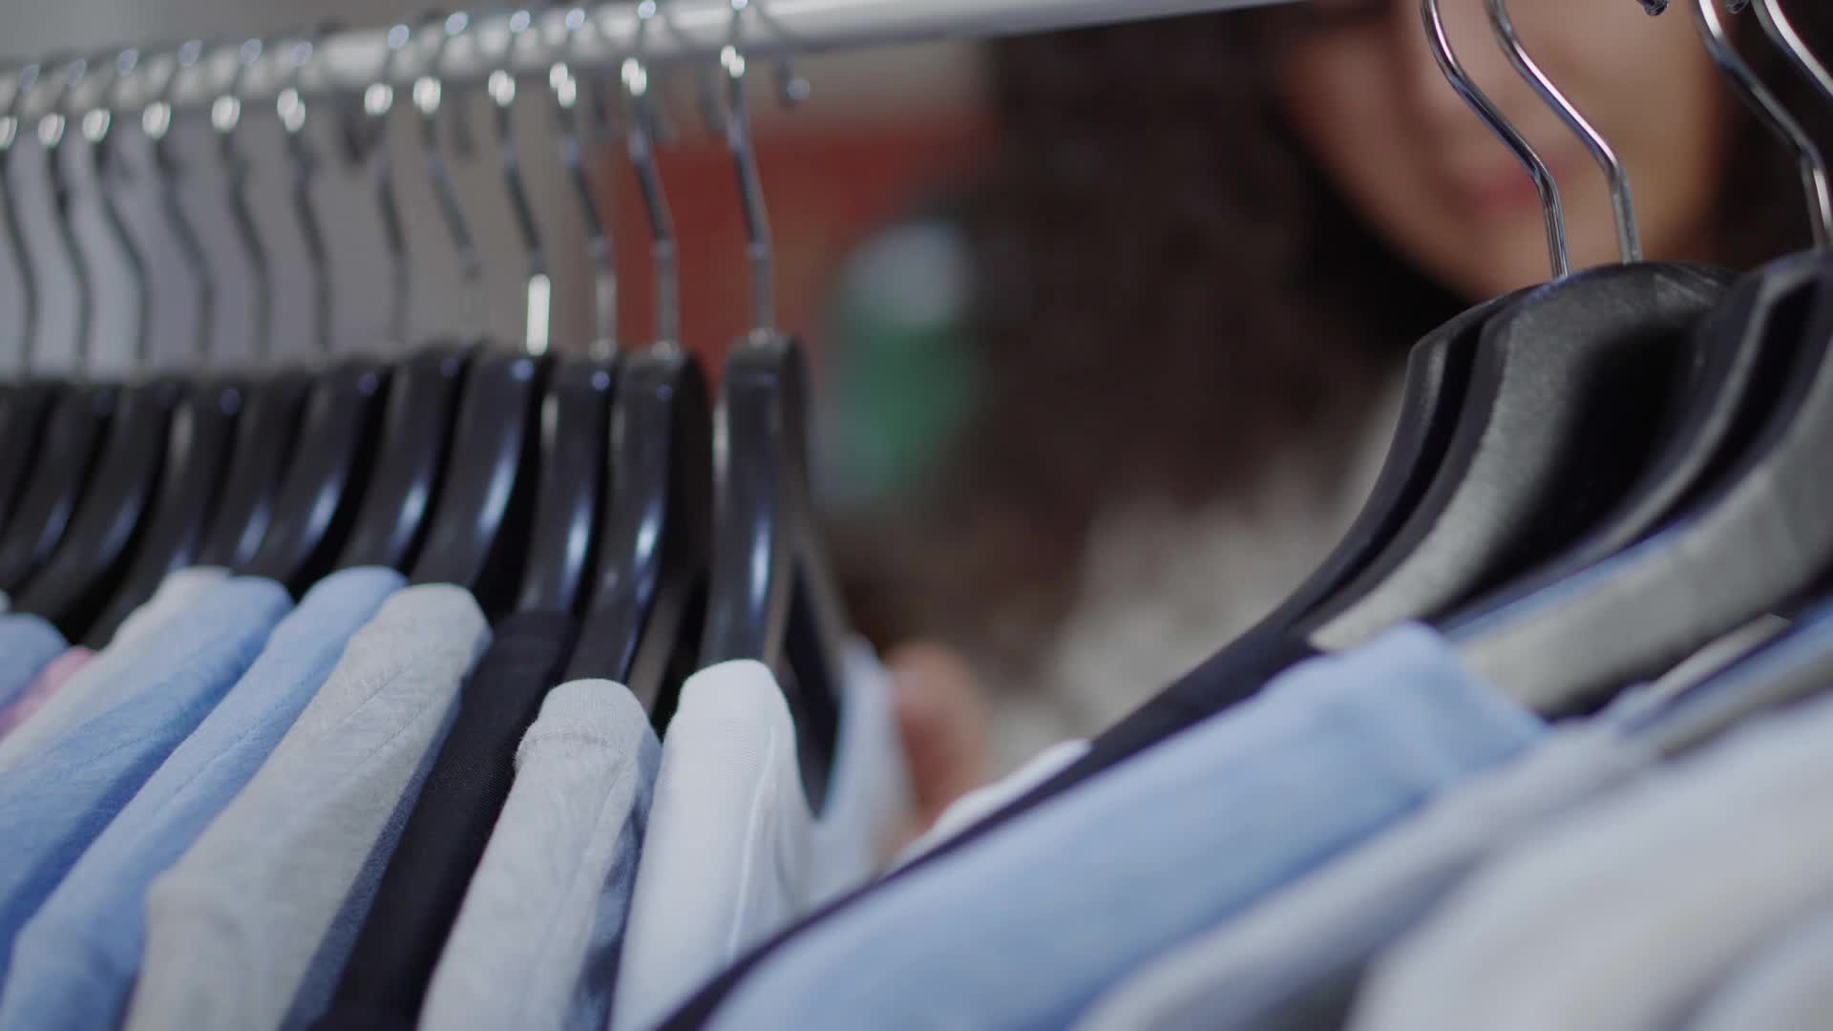
Making the right choices when it comes to clothes
Micheal J. Darby ( jonah68@gmail.com) 2023

Slide 2
Proper Dress and Clothing (Your Friend wants you to wear some reviling clothes.)
A. Cooperate wear the reviling
clothing.
B. Talk with the friend and tell her why
you will not be wearing the
suggested clothing and then
suggest an appropriate
alternative.
C. Stop associating with your
friend.

Slide 3
Right answer
Talk with a friend. Tell your friend why you will not wear the suggested clothing, and then offer an appropriate alternative.
Cooperating with your peers by wearing revealing clothes because you may lose a friendship should never be an option. Never allow another peer to dictate the kind of clothes you wear. It is essential to think for yourself.
Stop associating with a friend because of a dispute over wearing specific clothing should be the last result. Talk with you’re your friend or peer and tell them why you disapprove of wearing certain kinds of clothing and suggest an alternative outfit may be the best option. It is essential to dress appropriately to maintain a sense of dignity.

Slide 4
Wrong answer
Stop associating with your friend over a clothing dispute should be the last option.

Slide 5
Wrong answer
Proper Dress and Clothing
Your friend suggests wearing some revealing shorts or a tight top that will show some cleavage; what should be your response?
Go along with your friends and wear revealing clothing.

Slide 6
Several girls come to school wearing tight hot pants the administration have not addressed the situation, what should be your response if you are young lady?
A. Wear the same thing because
the administration has not
addressed the issue.
B. There is only one time to be
young therefore wear revealing
clothes while you can; you will
not always have an attractive
body.
C. Wear appropriate clothes nurture
your mind rather than expose
your body.

Slide 7
Right answer
Wear appropriate clothes to nurture your mind instead of exposing your body.
Wearing the suggested apparel because the administration has not addressed the issue of proper clothing should not be an option. It is essential to maintain a sense of modesty in all things; exposing your body during the young years tends to attract the wrong attention, sending the wrong signals. It is more important to cultivate and develop your mind than expose your body.

Slide 8
Wrong answer
Wear revealing clothes while young because you will not always have an attractive body.

Slide 9
Wrong answer
Several girls went to school wearing tight hot pants. The administration has not addressed the situation; what should be your response if you are a young lady?
Wear the same thing because the administration has not addressed the issue.

Slide 10
Most of the guys are wearing their pants pulled down, exposing their underwear; what should be the response of a young man who his peers influence?
A. Following the lead of others is a cool thing
to do.
B. Do your thing. Make sure that your pants
don’t accidentally slip off.
C. Think for yourself. Pull your
pants up, put on a belt, and act like
you have goals and objectives.

Slide 11
Right answer
Think for yourself, pull your pants up, put on a belt, and behave like you have goals and objectives.
Following the lead of other people when it comes to wearing clothes can lead to significant problems. Styles come and go every fad or style is not appropriate. It is never cool to show your underwear in public.

Slide 12
Wrong answer
Do your thing; make sure your pants don’t accidentally slip off.

Slide 13
Wrong answer
Some guys are wearing their pants pulled down, exposing their underwear; what should be the response of a young man influenced by his peers?
Follow the lead of the other guys. It is essential to be one of the fellows.

Slide 14
An expensive new dress style has come out you do not have the money to purchase the clothes, what should be your response?
A. Beg your parents or relatives to
purchase the outfit.
B. Save your allowance and
purchase the outfit.
C. New outfit styles come and
go; do your own thing, and be a
trendsetter.

Slide 15
Wrong answer
If an expensive new outfit comes out you do not have the money to purchase the outfit, what is the best response?
Beg your parents or relatives to purchase the outfit.

Slide 16
Right answer
Ignore the new outfit because new styles come and go. Do your own thing, be a trendsetter.
Begging your parents or relatives to purchase the outfit should not be the primary option. Trends come and go. Saving your allowance and purchasing the outfit is an option, but perhaps the best option is to ignore the outfit because styles come and go.

Slide 17
Wrong answer
Save your allowance and purchase the outfit. This may be an option, but it’s probably not the best option.

Slide 18
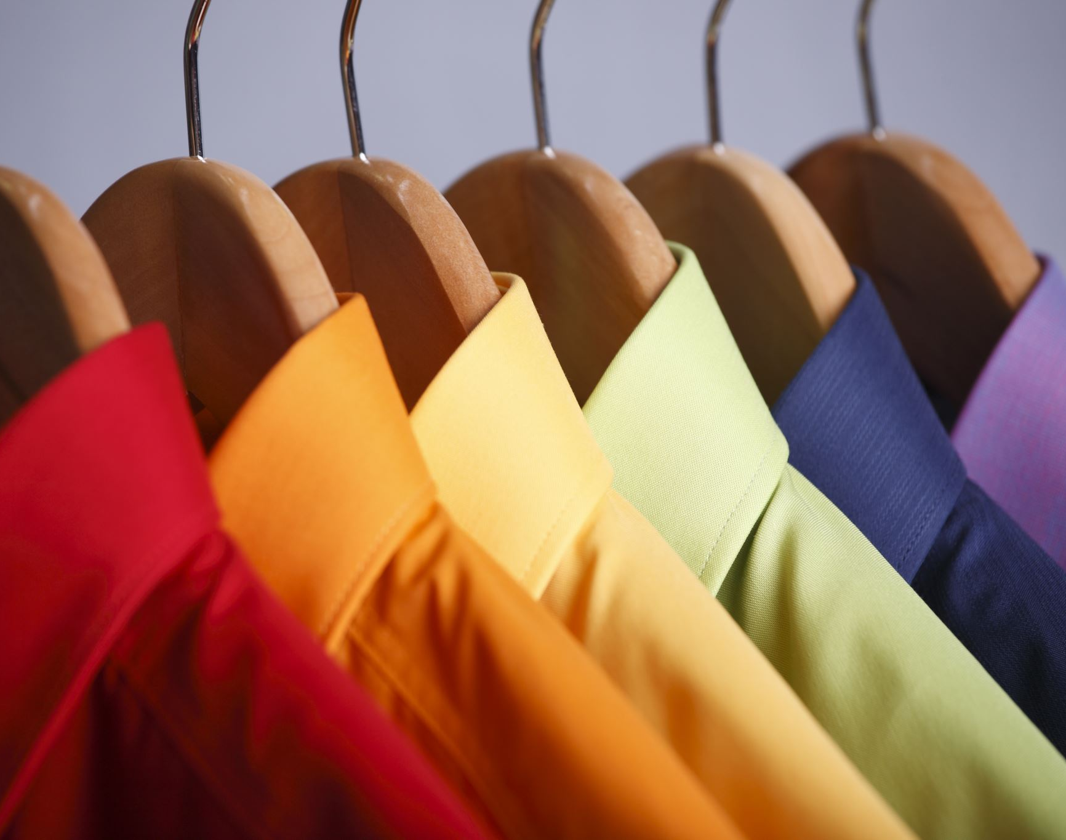
I have clothes in my closet that I do not wear, and most dresses are too tight; what is the best response?
A. Let the clothes stay in the
closet I may lose weight
B. Throw the clothes away they
are worthless
C. Donate clothes to a Non-
Profit

Slide 19
Right answer
Donate the clothes to a Goodwill store or a nonprofit organization that accepts used garments. All minors need to consult with their parents before making any decision on giving away clothes
If your clothes are too tight, they should not be worn. Losing enough weight to wear the clothes is an option, but the best option is to donate the clothes to a Good Will store or some other nonprofit store. Giving usually leads to significant blessings.

Slide 20
Wrong answer
Throw the clothes away; they are worthless.

Slide 21
Wrong answer
I have clothes in my closet that I do not wear, and most of the clothes are too tight; what is the best response?
Let the clothes remain in my closet because I may lose weight and wear them one day. This is an option, but most people let the clothes remain in their closet without taking action.

Slide 22
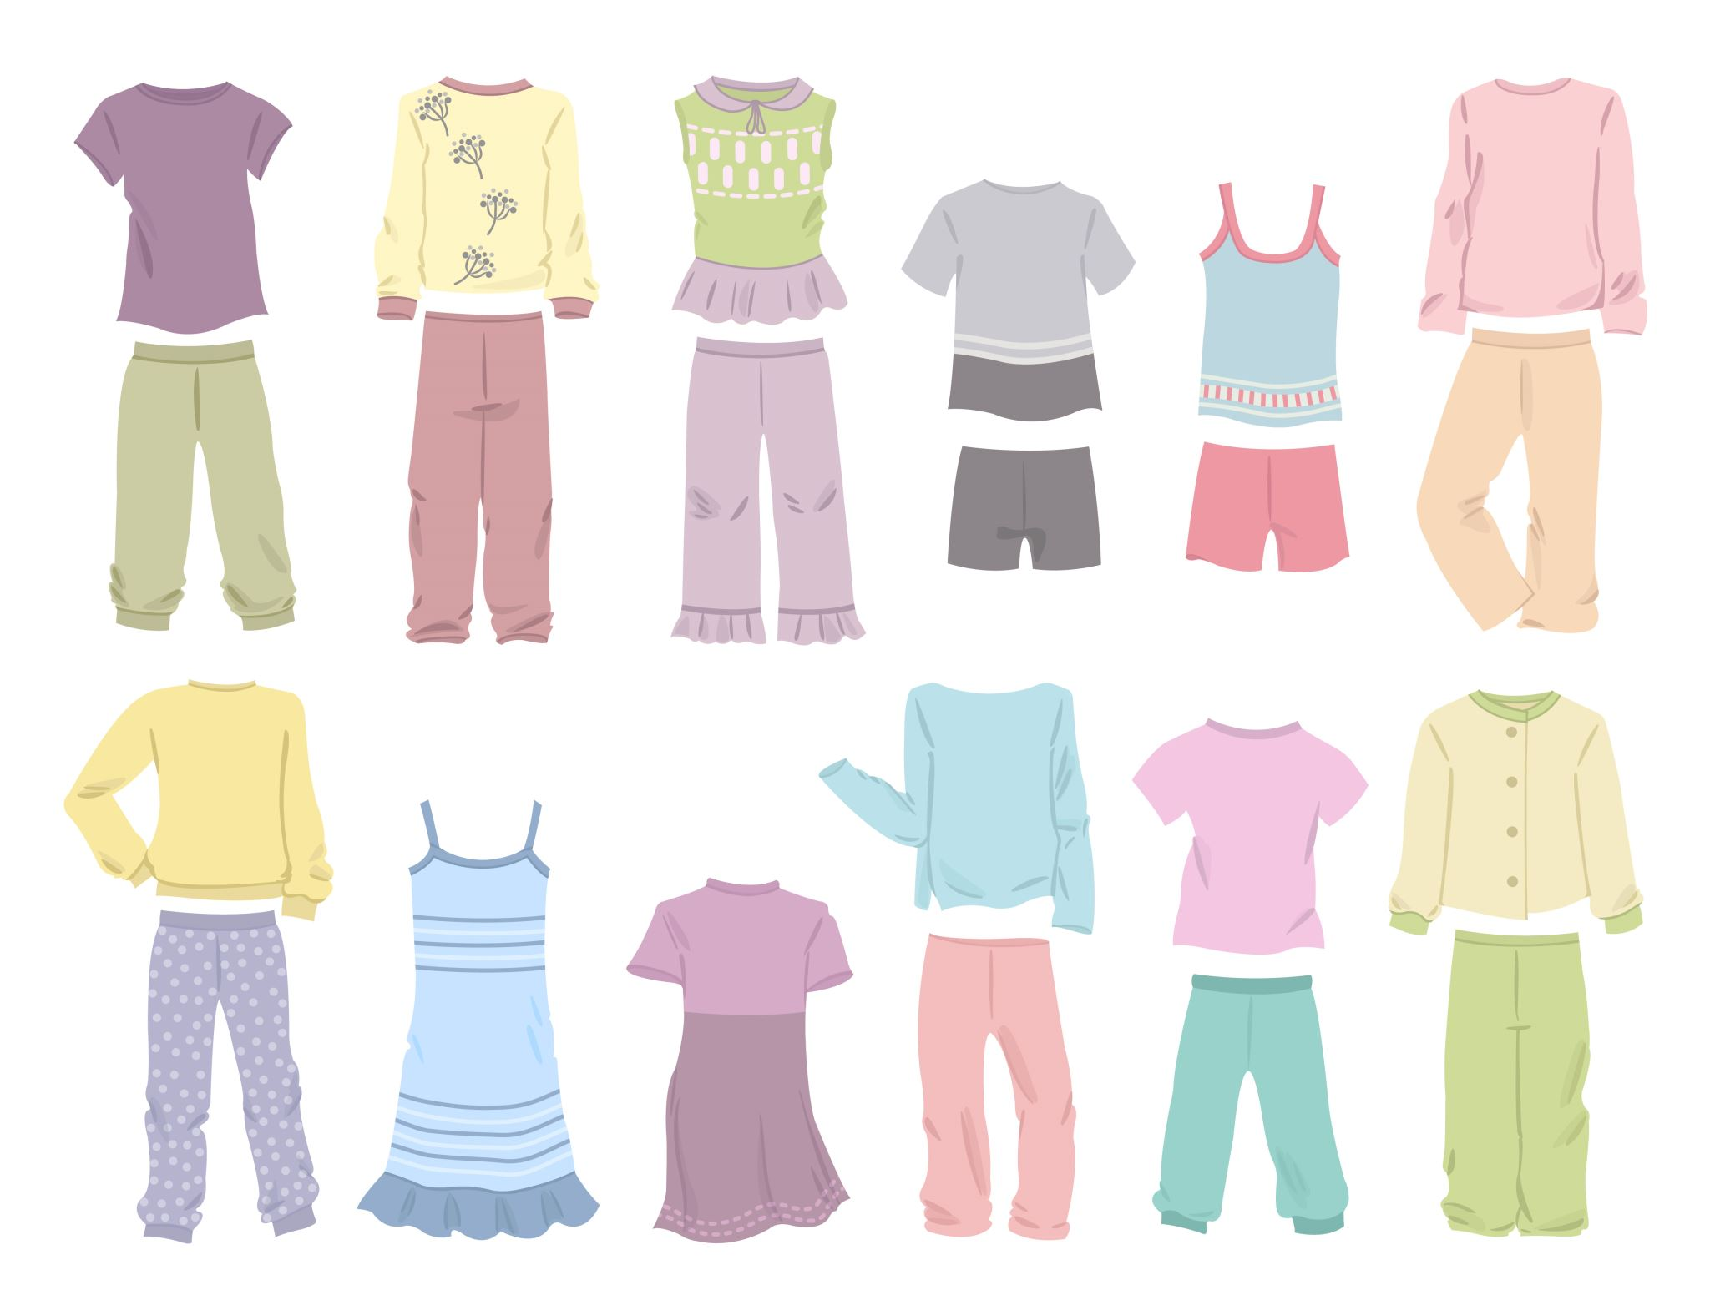
The temperature has dropped below freezing. I have a beautiful blouse, designer shorts, and flip-flops, I desire to wear these items, and I do not want to wait until it warms up; what is the best response?
A. Wear the clothes you probably
will not get sick.
B. Put the clothes away and wait
until the clothes are in season.
C. Wait a few days until it warms
up, then wear the clothes.

Slide 23
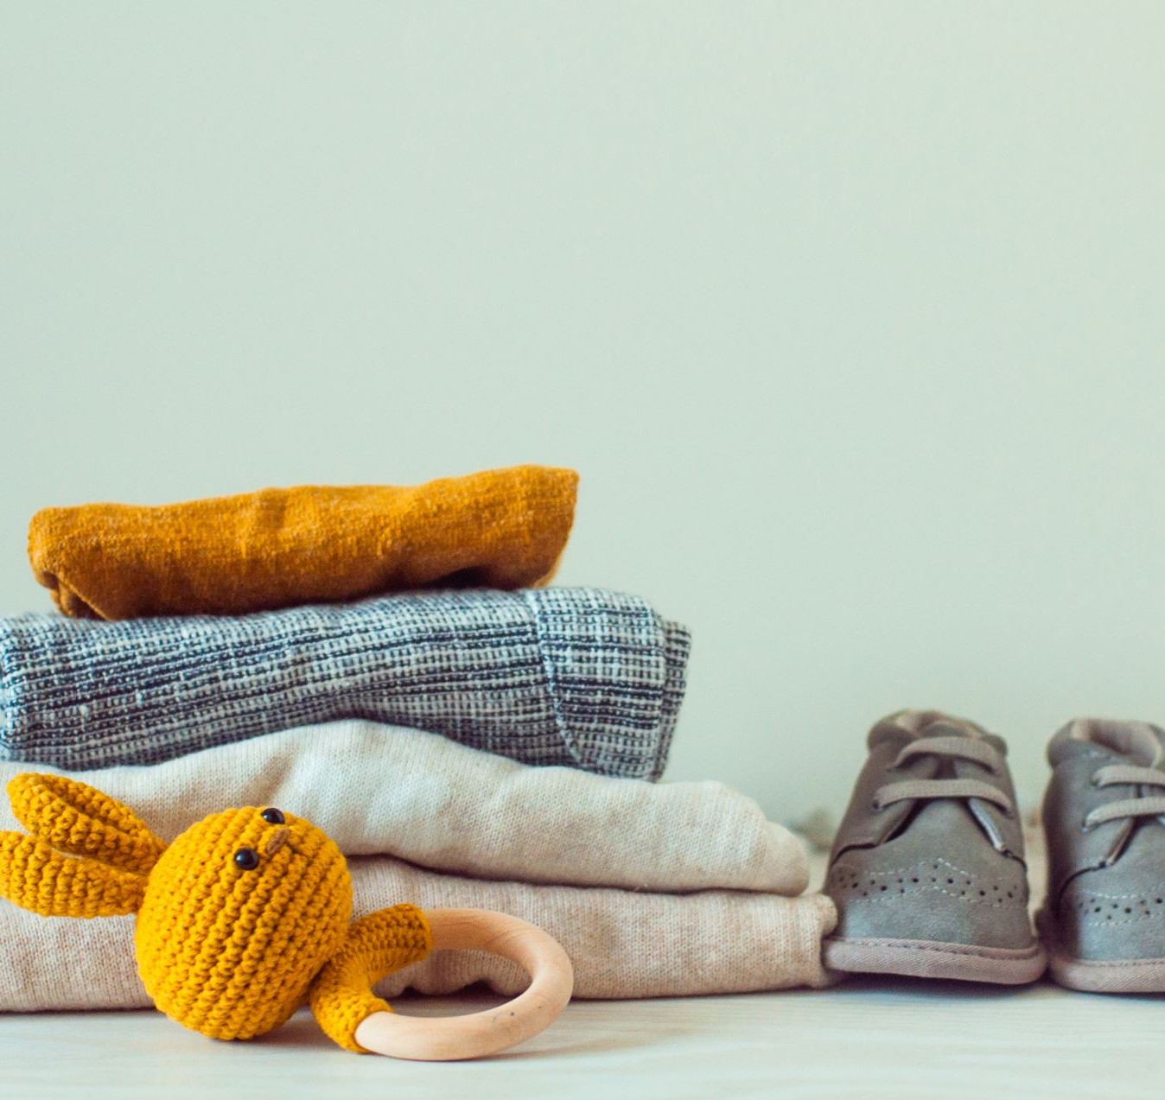
Wrong Answer
Wait a few days until it warms up, then wear the clothes. This may be an option, but it’s not the best option.

Slide 24
Wrong answer
The temperature has dropped below freezing. I have a beautiful blouse or shirt, designer shirts, and flip flops; I desire to wear the items; I do not want to wait until it warms up; what is the best response?
Wear the clothes you probably will not get sick.

Slide 25
Right answer
Put the clothes away and wait until the clothes are in season.
Wait a few days until it warms up, then wear the clothes
When it comes to wearing appropriate clothes during cold weather, it is essential to be cautious. My grandfather was very wise; he had a lot of wisdom and common sense. He believed that the failure to wear proper clothing during freezing weather would cause arthritis in later life, and a failure to shield your head from the sun on extremely hot or cold days can lead to health problems later in life.
There is a story of a beautiful young lady who always wanted to wear a short sleeve blouse during the cold weather; she did not want to wear a coat. Her mother ensured she had a warm jacket before leaving the house, but as soon as she was out of sight of her mother, she would pull off the jacket. It is said that she later came down with pneumonia and died. Most people believe her death was due to her failure to wear appropriate warm clothing during winter.

Slide 26
My peers encouraged me to go with them to purchase some expensive clothes and shoes from a young man at rock bottom prices; what is the best response?
A. Go with your peers and
purchase as much merchandise
as possible.
B. Be cautious; the items could be
stolen; take a chance.
C. Refuse to go with your peers;
purchase your clothes and shoes
from a legitimate source.

Slide 27
Wrong answer
My peers encouraged me to go with him to purchase some expensive clothes and shoes from a young man at rock bottom prices; what is the best response?
Go with your peers to purchase as much merchandise as possible.

Slide 28
Right answer
Refuse to go with your peers; purchase your clothes and shoes from a legitimate source.
Going with a peer or friend to purchase the merchandise could be harmful. A red flag should go up if expensive clothes or jewelry are sold at rock bottom prices. There is a chance the merchandise was stolen. Buying stolen goods is a crime. The best option is to purchase clothing, shoes, and jewelry from a legitimate store or site.

Slide 29
Wrong answer
Be cautious; the items could be hot but take a chance. The best answer to refuse to purchase the items

Slide 30
You have strong views. Some of your ideas are negative and are geared toward various political or cultural groups (a company has made some tee shirts that represent your views); what should be your response?
A. Purchase and wear your tee shirt. be proud of your personal views.
1
C. Refuse to purchase the tee-shirt strive to change your views.
3
B. Purchase the tee shirt and keep it in your closet.
2

Slide 31
Right answer
Right Answer Refuse to purchase the tee shirt. Strive to change your views.
Purchasing a tee shirt with a negative print and wearing it should never be an option. It is easy to become a target of someone else’s hatred. Buying a negative tee shirt and keeping it in your closet as a collector’s item should not be an option. If a purchase is made, there is a temptation to wear the clothing. The best option is to refuse to purchase the tee shirt and change to a more favorable position. There is no place for hatred of other people and other cultures. We must find ways to get along with others from different backgrounds and cultures. There is some good in everyone.

Slide 32
Wrong answer
Purchase the tee shirt and keep it in your closet as a collector’s item.

Slide 33
Wrong answer
Some of your personal views are targeted toward various political or cultural groups; a company has made some tee shirts representing your views; what should be your response?
Purchase and wear your tee shirt; be proud of your personal views.

Slide 34
Disagreements arise over wearing choir colors. What should be your response?
A. Disagree with the choir director’s protest by wearing your colors.
B. Refuse to attend the event.
C. Wear the colors to support the choir; it is not about one person’s preference.

Slide 35
Right answer
Wear the colors that support the choir; it is not about one person’s preference.
A refusal to attend the event should be an option. If you are a choir member, it is essential to support the choir. Disagreeing with the choir president or director by wearing a different color or outfit should not be an option. The best option is to support the choir by wearing the suggested colors because it is not about one person’s preference or desires. It is about singing for the Glory of God.

Slide 36
Wrong answer
Disagree with the choir director protest by wearing your personal colors.

Slide 37
Wrong answer
The choir director has named the colors for the upcoming event you are a choir member you do not like the colors, what should be your response?
Refuse to attend the event.

Slide 38
The teacher suggests going on a field trip through the woods; what is the best footwear for the exploration?
A. Closed in walking shoes
B. Flip flops or open sandals
C. High top boots

Slide 39
Right answer
The teacher suggests going on a field trip through the woods; what is the best footwear for the exploration?
Wear Closed in walking shoes.
Wearing flip-flops and open sandals should not be an option when walking in the woods; there is a danger of injuring your foot or stomping your toe. High-top boots can be worn but may be uncomfortable. The best option is closed in walking shoes unless otherwise instructed by the teacher or supervisor to wear some other footwear.

Slide 40
Wrong answer
Wear High Top Boots.

Slide 41
Wrong answer
Wear Flip flops or Open sandals.

